Slide 1
MPOPF Simulation and OpenDSS Validation
Aryan Ritwajeet Jha
Graduate Research Assistant
Washington State University
Notes:
Remember to hit the reset button to make sure all the page elements react properly.
There are 20 different layouts that you can choose from.

Slide 2
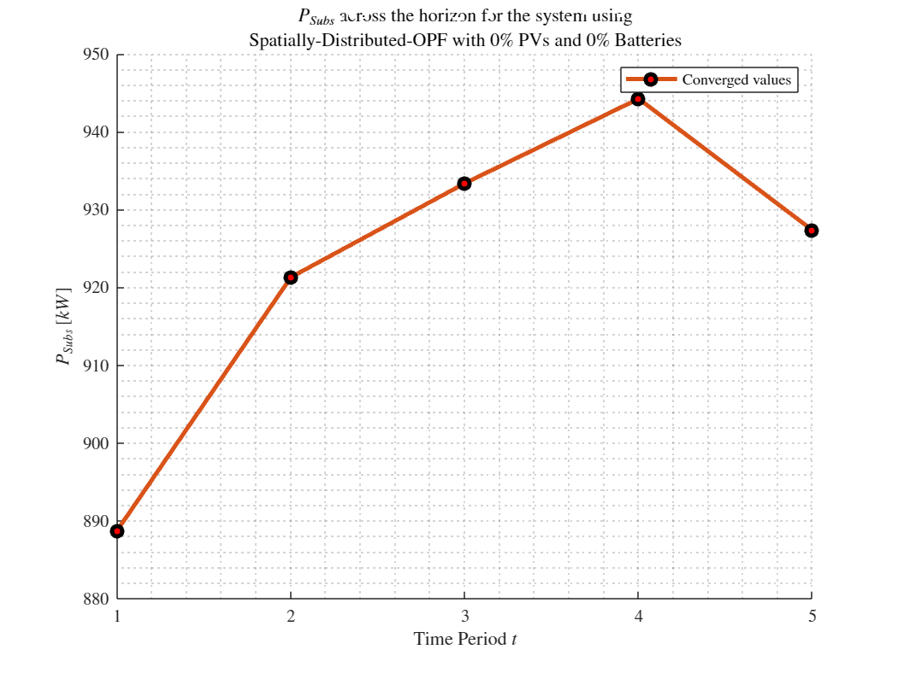
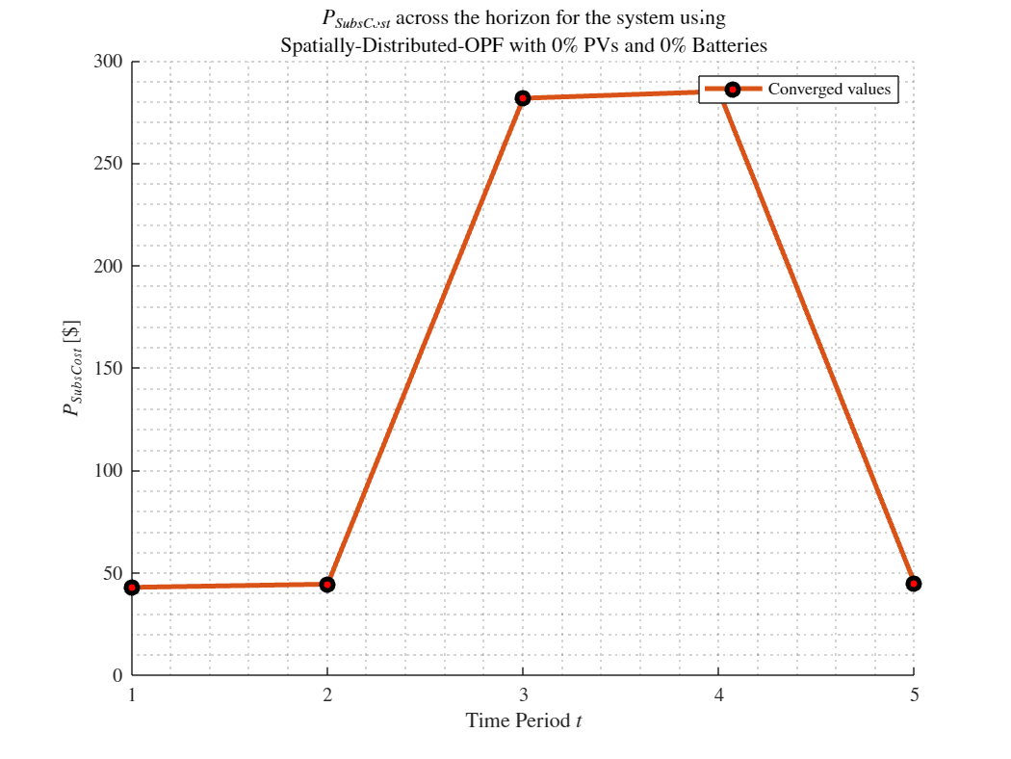
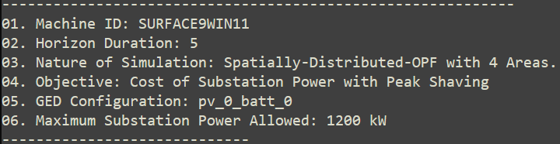
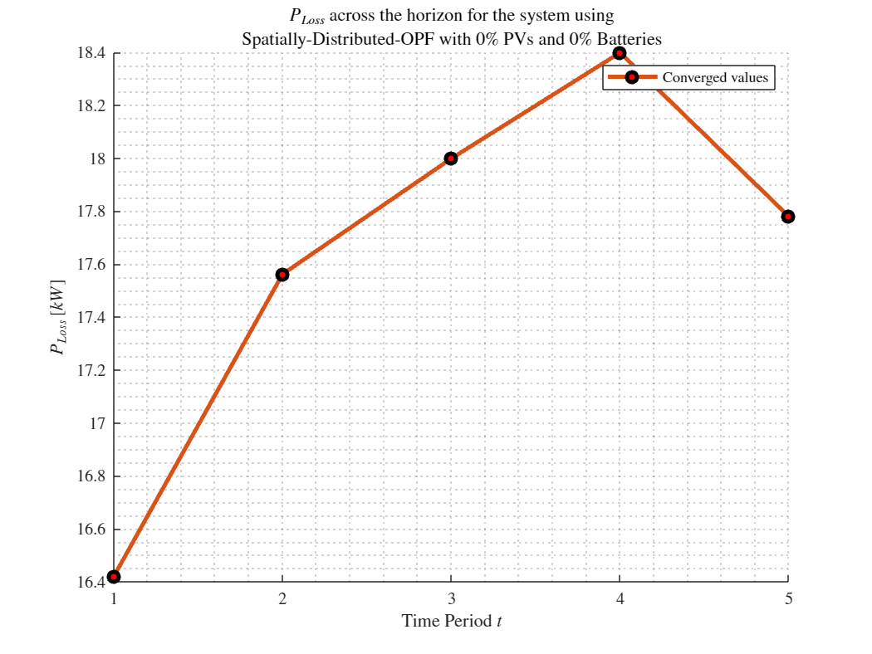
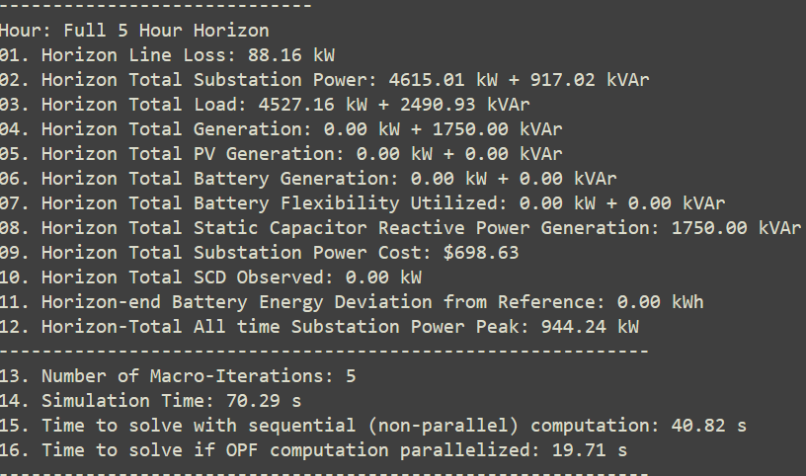
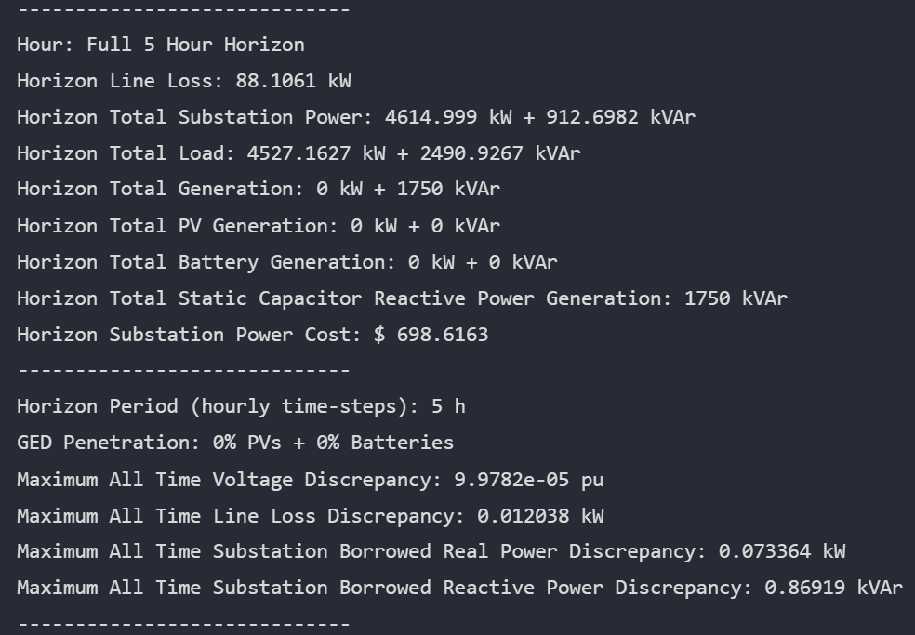

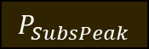



MPDOPF Verified for $T=5, PV=0\%, Batt=0\%$
strLoadShapeCost = 'New Loadshape.LoadShapeCost npts =5 interval = 1 mult = [0.048204 0.048204 0.30181 0.30181 0.048204]'
$P_{Subs}^{t}$
$P_{SubsCost}^{t}$
OpenDSS Def Profiles
Gen Cost+ Peak Shave
OpenDSS Powerflow Results
$$P_{Loss}^{t}$$
MPDOPF Simulation Results
Objective
$$P_{SubsPeak}$$
Timings
Discrepancies

Slide 3
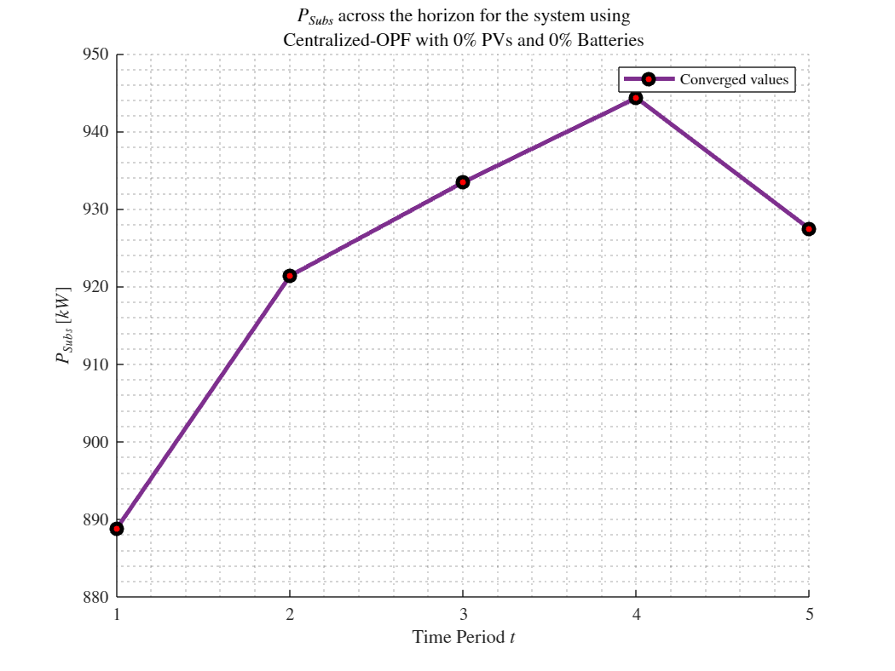
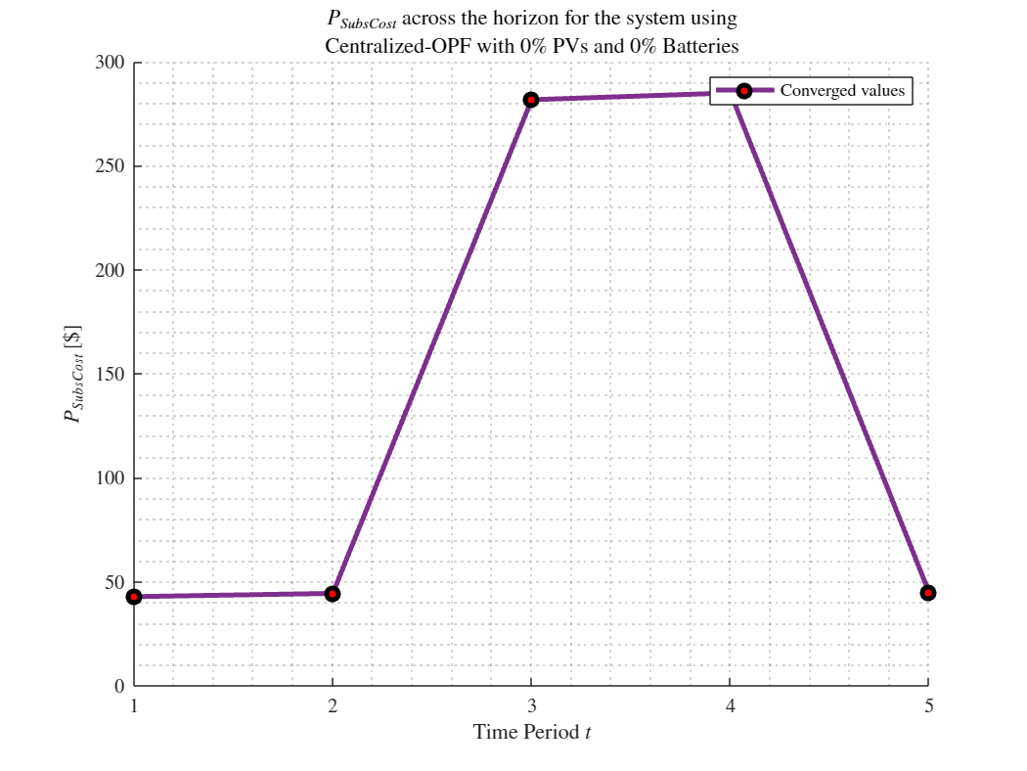
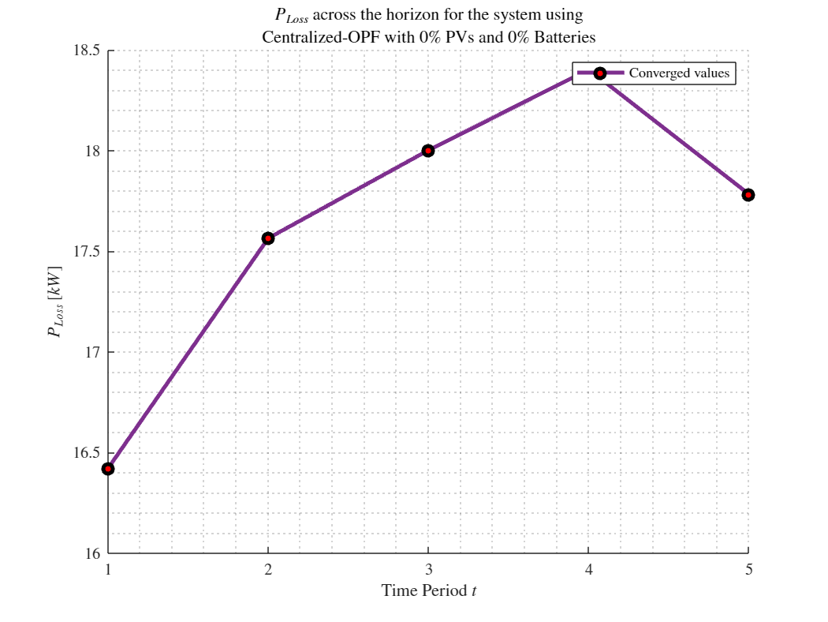
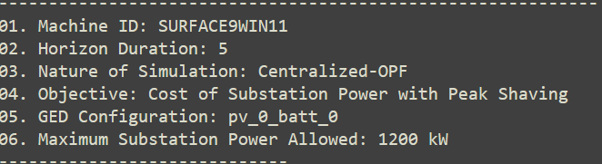
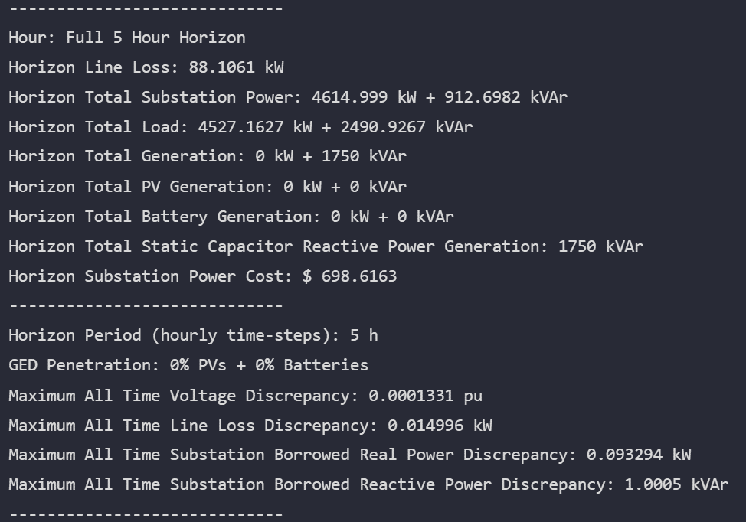
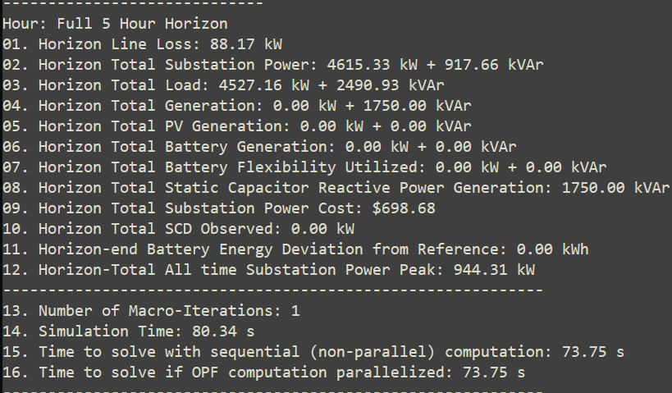


MPCOPF Verified for $T=5, PV=0\%, Batt=0\%$
strLoadShapeCost = 'New Loadshape.LoadShapeCost npts =5 interval = 1 mult = [0.048204 0.048204 0.30181 0.30181 0.048204]'
$P_{Subs}^{t}$
$P_{SubsCost}^{t}$
OpenDSS Def Profiles
Gen Cost + Peak Shave
OpenDSS Powerflow Results
$$P_{Loss}^{t}$$
MPDOPF Simulation Results
Objective
$$P_{SubsPeak}$$
Timings
Discrepancies

Slide 4
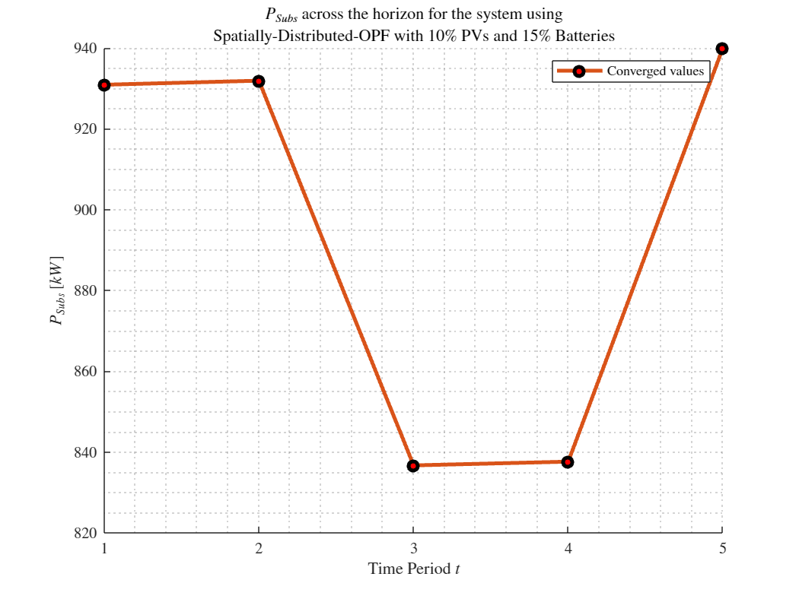
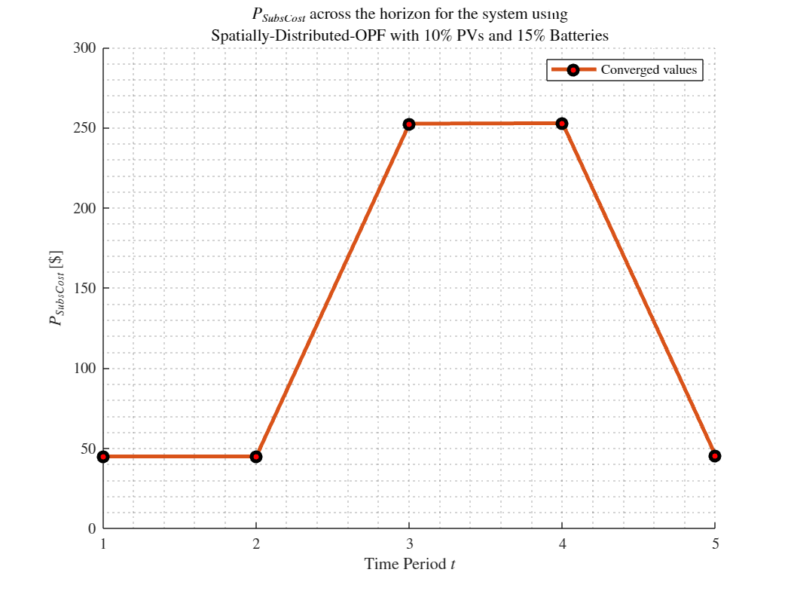
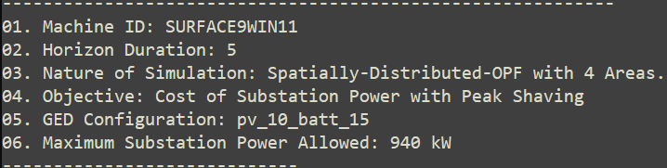
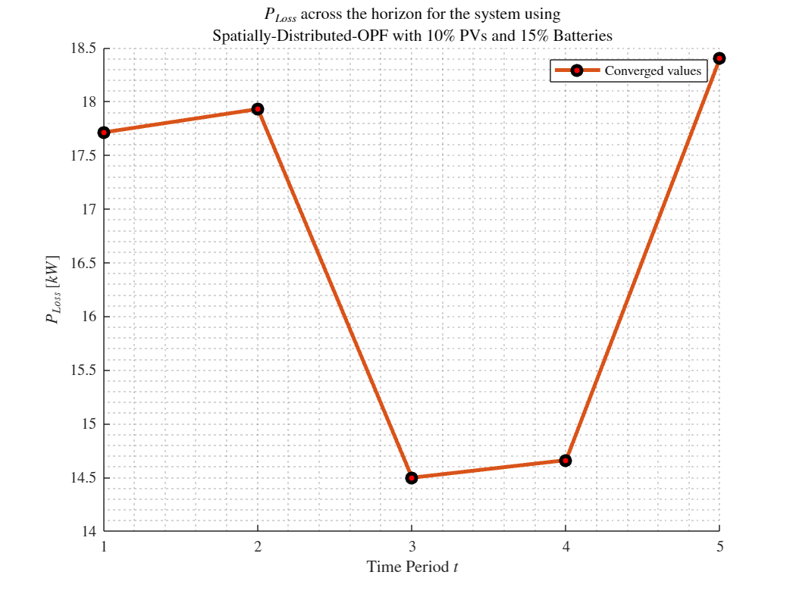
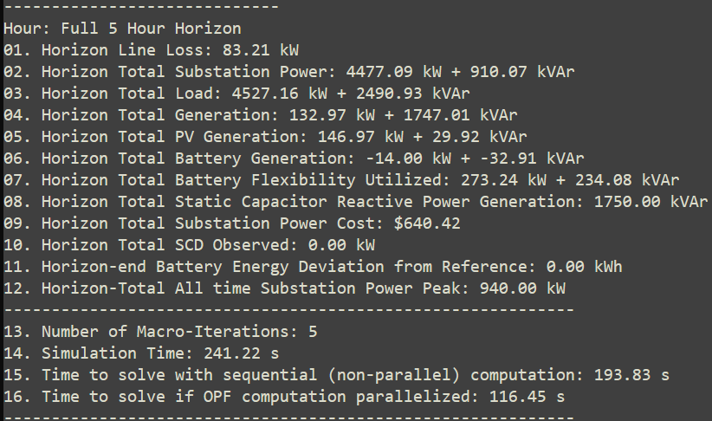
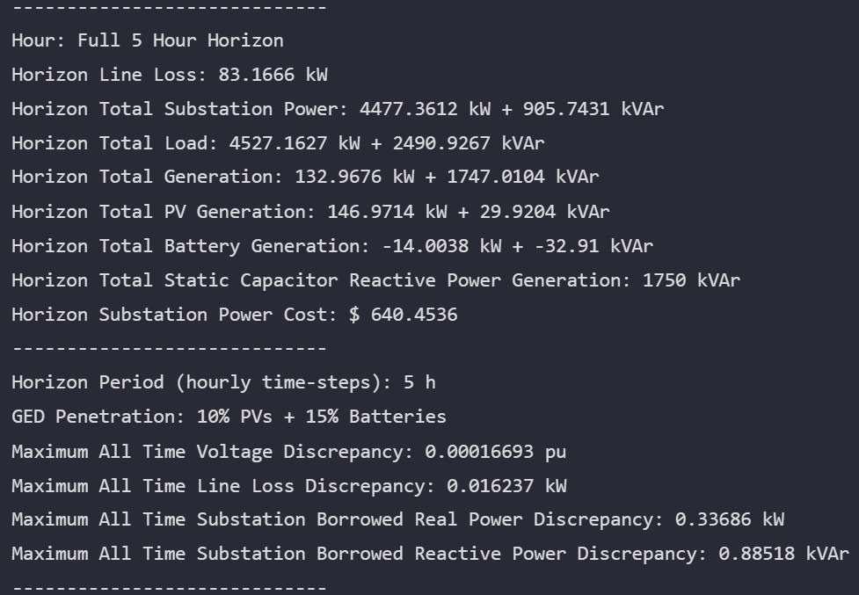

MPDOPF Verified for $T=5, PV=10\%, Batt=15\%$
strLoadShapeCost = 'New Loadshape.LoadShapeCost npts =5 interval = 1 mult = [0.048204 0.048204 0.30181 0.30181 0.048204]'
$P_{Subs}^{t}$
$P_{SubsCost}^{t}$
OpenDSS Def Profiles
Gen Cost + Peak Shave
OpenDSS Powerflow Results
$$P_{Loss}^{t}$$
MPDOPF Simulation Results
Objective
$$P_{SubsPeak}$$
Timings
Discrepancies

Slide 5
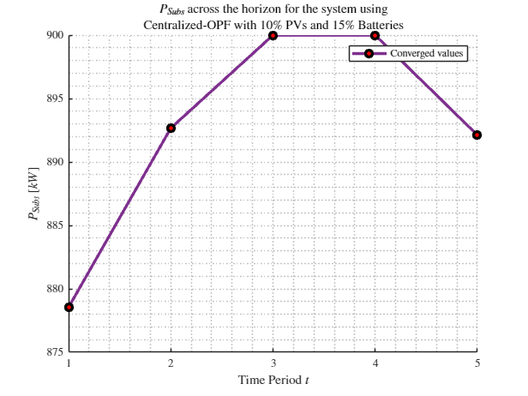
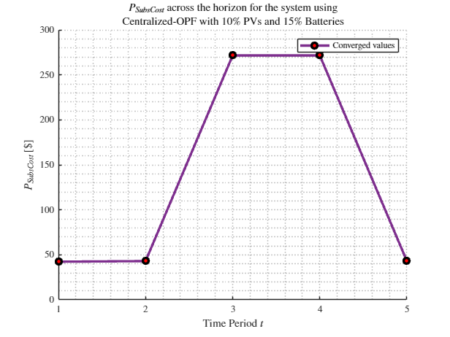
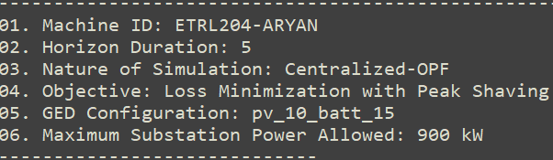
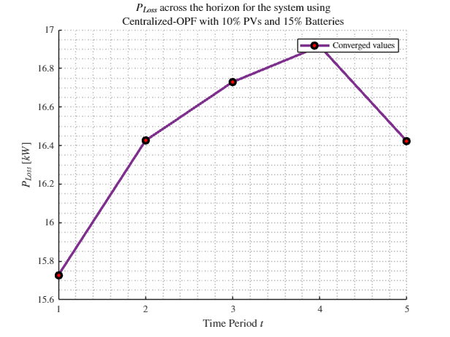
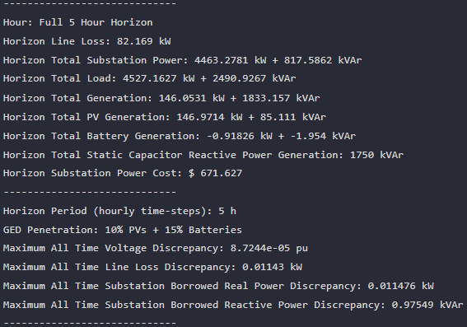
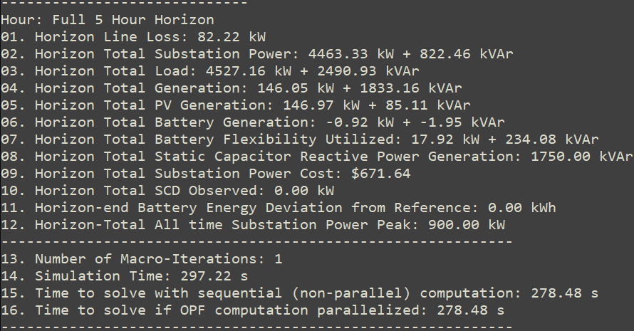

MPCOPF Verified for $T=5, PV=10\%, Batt=15\%$
strLoadShapeCost = 'New Loadshape.LoadShapeCost npts =5 interval = 1 mult = [0.048204 0.048204 0.30181 0.30181 0.048204]'
$P_{Subs}^{t}$
$P_{SubsCost}^{t}$
OpenDSS Def Profiles
Gen Cost + Peak Shave
OpenDSS Powerflow Results
$$P_{Loss}^{t}$$
MPDOPF Simulation Results
Objective
$$P_{SubsPeak}$$
Timings
Discrepancies

Slide 6

MPDOPF Verified for $T=5, PV=10\%, Batt=15\%$
strLoadShapeCost = 'New Loadshape.LoadShapeCost npts =5 interval = 1 mult = [0.048204 0.048204 0.30181 0.30181 0.048204]'
OpenDSS Def Profiles
Gen Cost + Peak Shave

Slide 7
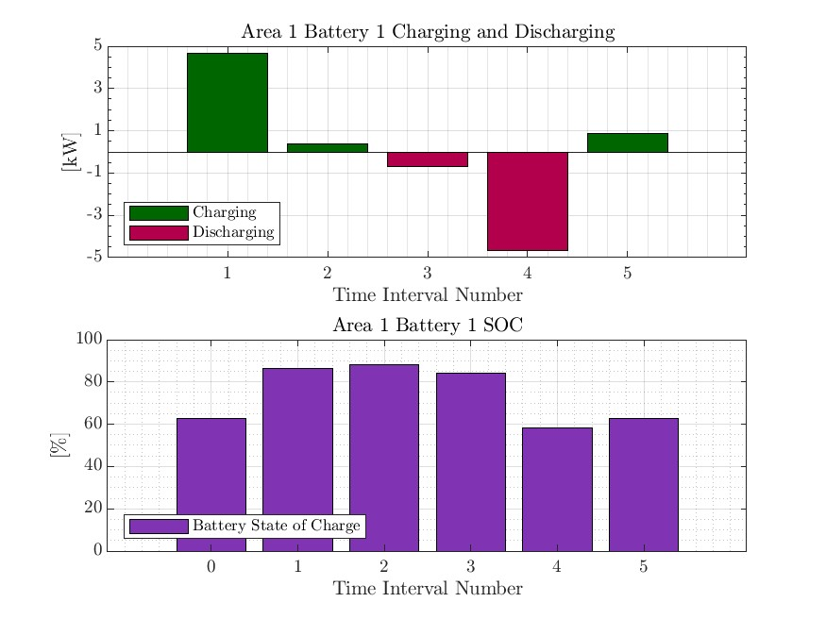
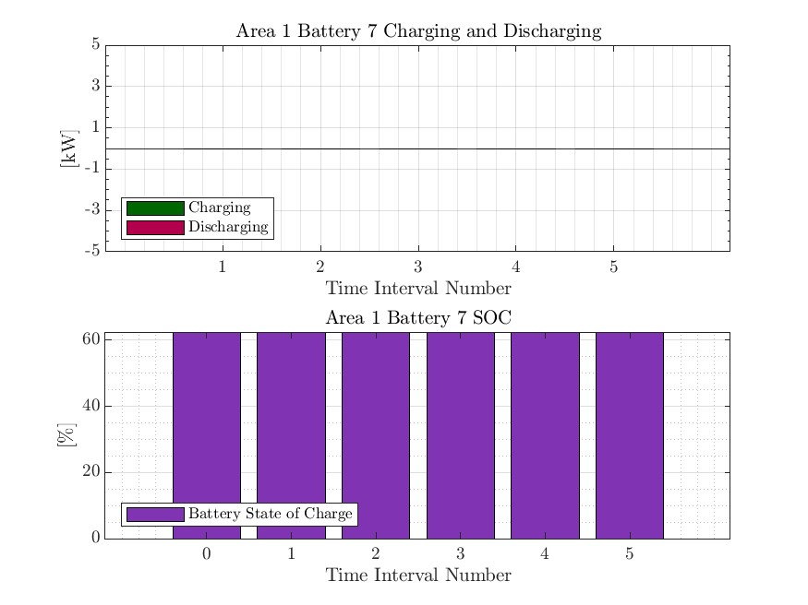
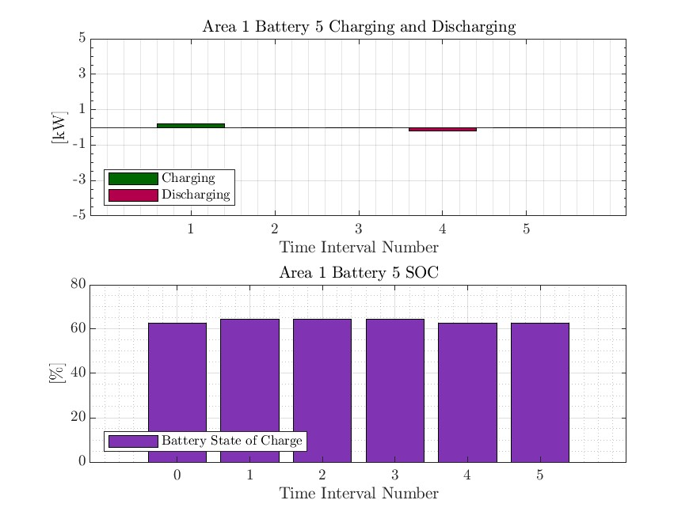


MPCOPF Verified for $T=5, PV=10\%, Batt=15\%$
strLoadShapeCost = 'New Loadshape.LoadShapeCost npts =5 interval = 1 mult = [0.048204 0.048204 0.30181 0.30181 0.048204]'
OpenDSS Def Profiles
Gen Cost + Peak Shave

Slide 8
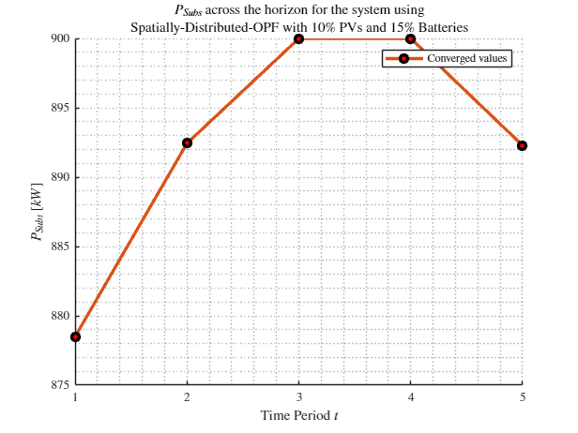
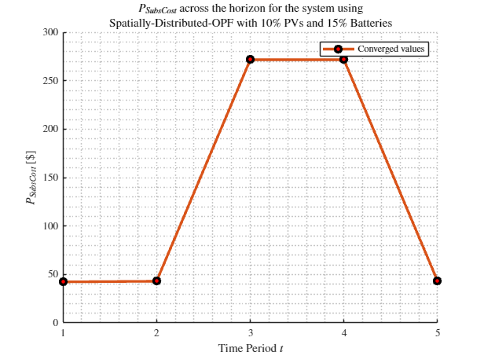
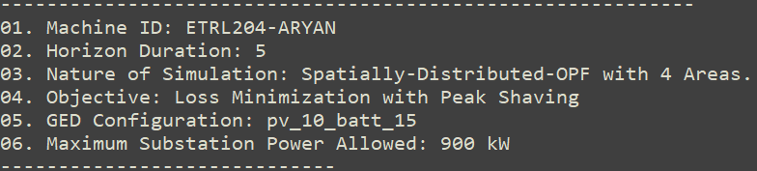
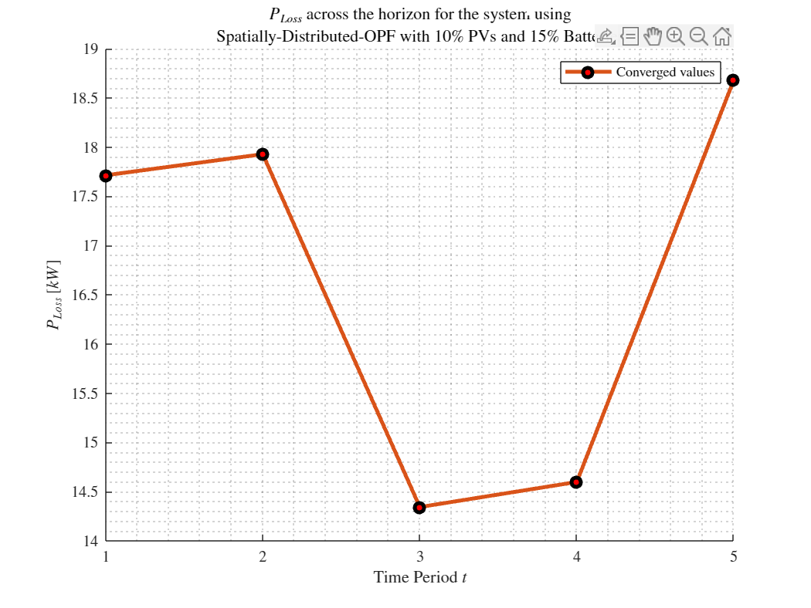

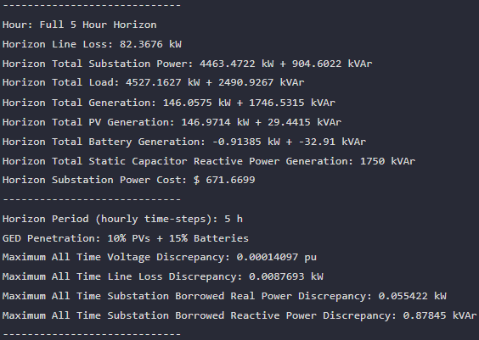

MPDOPF Verified for $T=5, PV=20\%, Batt=30\%$
strLoadShapeCost = 'New Loadshape.LoadShapeCost npts =5 interval = 1 mult = [0.048204 0.048204 0.30181 0.30181 0.048204]'
$P_{Subs}^{t}$
$P_{SubsCost}^{t}$
OpenDSS Def Profiles
Gen Cost + Peak Shave
OpenDSS Powerflow Results
$$P_{Loss}^{t}$$
MPDOPF Simulation Results
Objective
$$P_{SubsPeak}$$
Timings
Discrepancies

Slide 9

MPCOPF Verified for $T=5, PV=20\%, Batt=30\%$
strLoadShapeCost = 'New Loadshape.LoadShapeCost npts =5 interval = 1 mult = [0.048204 0.048204 0.30181 0.30181 0.048204]'
$P_{Subs}^{t}$
$P_{SubsCost}^{t}$
OpenDSS Def Profiles
Gen Cost + Peak Shave
OpenDSS Powerflow Results
$$P_{Loss}^{t}$$
MPDOPF Simulation Results
Objective
$$P_{SubsPeak}$$
Timings
Discrepancies

Slide 10

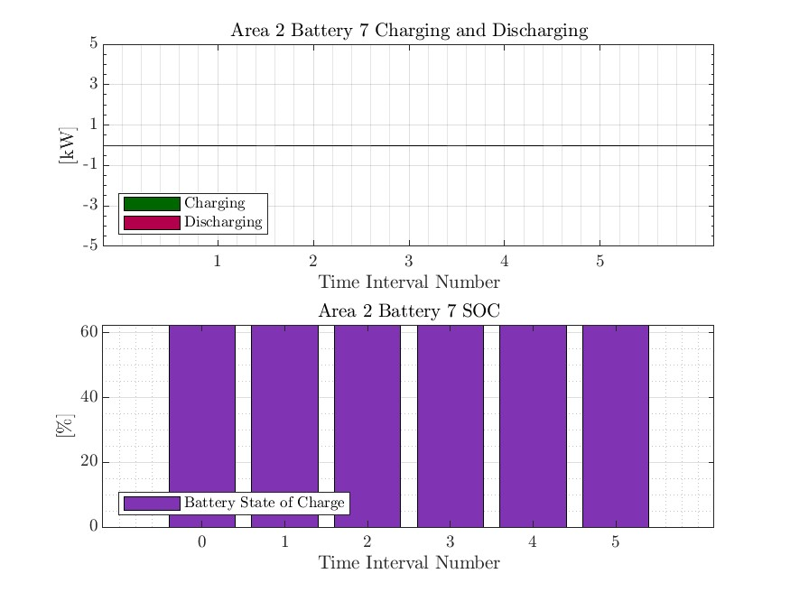



MPDOPF Verified for $T=5, PV=20\%, Batt=30\%$
strLoadShapeCost = 'New Loadshape.LoadShapeCost npts =5 interval = 1 mult = [0.048204 0.048204 0.30181 0.30181 0.048204]'
OpenDSS Def Profiles
Gen Cost + Peak Shave

Slide 11

MPCOPF Verified for $T=5, PV=20\%, Batt=30\%$
strLoadShapeCost = 'New Loadshape.LoadShapeCost npts =5 interval = 1 mult = [0.048204 0.048204 0.30181 0.30181 0.048204]'
OpenDSS Def Profiles
Gen Cost + Peak Shave

Slide 12

MPDOPF Verified for $T=5, PV=30\%, Batt=45\%$
strLoadShapeCost = 'New Loadshape.LoadShapeCost npts =5 interval = 1 mult = [0.048204 0.048204 0.30181 0.30181 0.048204]'
$P_{Subs}^{t}$
$P_{SubsCost}^{t}$
OpenDSS Def Profiles
Gen Cost + Peak Shave
OpenDSS Powerflow Results
$$P_{Loss}^{t}$$
MPDOPF Simulation Results
Objective
$$P_{SubsPeak}$$
Timings
Discrepancies

Slide 13

MPCOPF Verified for $T=5, PV=30\%, Batt=45\%$
strLoadShapeCost = 'New Loadshape.LoadShapeCost npts =5 interval = 1 mult = [0.048204 0.048204 0.30181 0.30181 0.048204]'
$P_{Subs}^{t}$
$P_{SubsCost}^{t}$
OpenDSS Def Profiles
Gen Cost + Peak Shave
OpenDSS Powerflow Results
$$P_{Loss}^{t}$$
MPDOPF Simulation Results
Objective
$$P_{SubsPeak}$$
Timings
Discrepancies

Slide 14

MPDOPF Verified for $T=5, PV=30\%, Batt=45\%$
strLoadShapeCost = 'New Loadshape.LoadShapeCost npts =5 interval = 1 mult = [0.048204 0.048204 0.30181 0.30181 0.048204]'
OpenDSS Def Profiles
Gen Cost + Peak Shave

Slide 15

MPCOPF Verified for $T=5, PV=30\%, Batt=45\%$
strLoadShapeCost = 'New Loadshape.LoadShapeCost npts =5 interval = 1 mult = [0.048204 0.048204 0.30181 0.30181 0.048204]'
OpenDSS Def Profiles
Gen Cost + Peak Shave

Slide 16
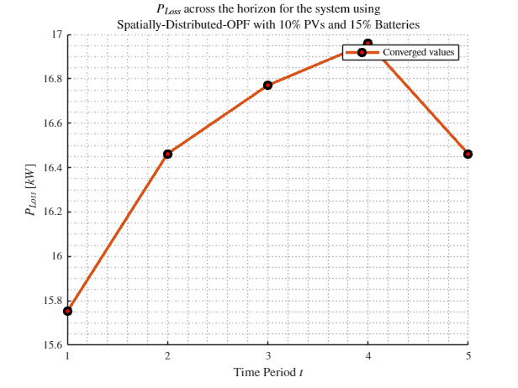
MPDOPF Verified for $T=5, PV=10\%, Batt=15\%$
strLoadShapeCost = 'New Loadshape.LoadShapeCost npts =5 interval = 1 mult = [0.048204 0.048204 0.30181 0.30181 0.048204]'
$P_{Subs}^{t}$
$P_{SubsCost}^{t}$
OpenDSS Def Profiles
Gen Cost + Peak Shave
OpenDSS Powerflow Results
$$P_{Loss}^{t}$$
MPDOPF Simulation Results
Objective
$$P_{SubsPeak}$$
Timings
Discrepancies

Slide 17
MPCOPF Verified for $T=5, PV=10\%, Batt=15\%$
strLoadShapeCost = 'New Loadshape.LoadShapeCost npts =5 interval = 1 mult = [0.048204 0.048204 0.30181 0.30181 0.048204]'
$P_{Subs}^{t}$
$P_{SubsCost}^{t}$
OpenDSS Def Profiles
Gen Cost + Peak Shave
OpenDSS Powerflow Results
$$P_{Loss}^{t}$$
MPDOPF Simulation Results
Objective
$$P_{SubsPeak}$$
Timings
Discrepancies

Slide 18
MPDOPF Verified for $T=5, PV=10\%, Batt=15\%$
strLoadShapeCost = 'New Loadshape.LoadShapeCost npts =5 interval = 1 mult = [0.048204 0.048204 0.30181 0.30181 0.048204]'
OpenDSS Def Profiles
Gen Cost + Peak Shave

Slide 19
MPCOPF Verified for $T=5, PV=10\%, Batt=15\%$
strLoadShapeCost = 'New Loadshape.LoadShapeCost npts =5 interval = 1 mult = [0.048204 0.048204 0.30181 0.30181 0.048204]'
OpenDSS Def Profiles
Gen Cost + Peak Shave

Slide 20
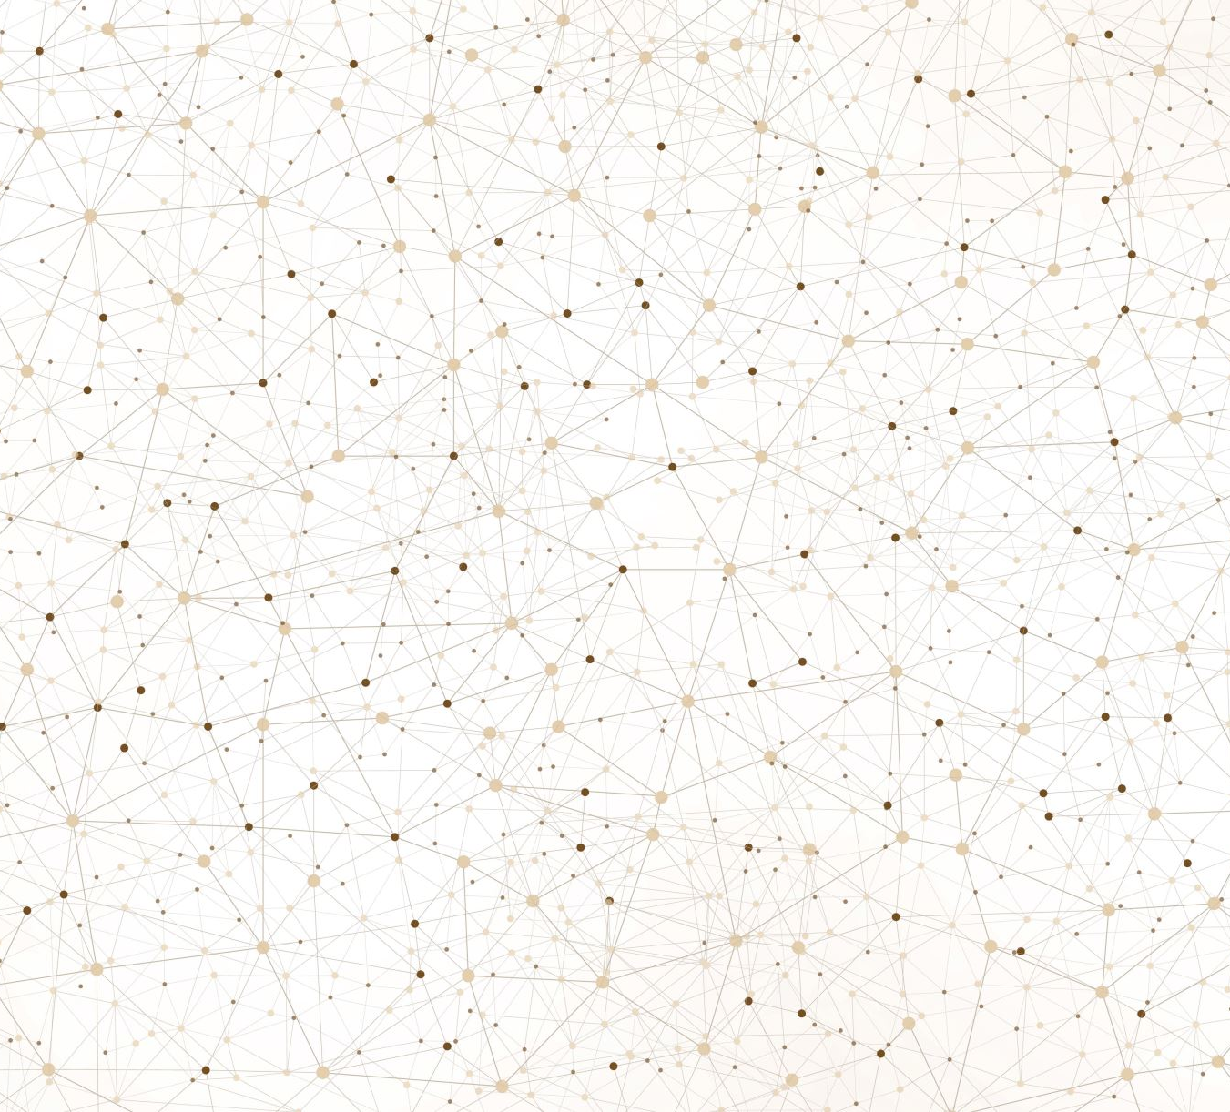
Latest Slides End Here.
Previous Slides Follow

Slide 21
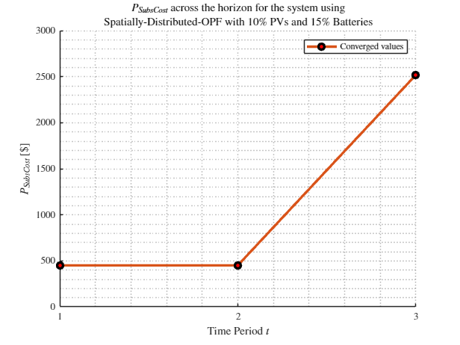
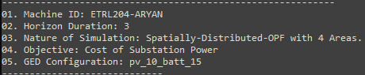
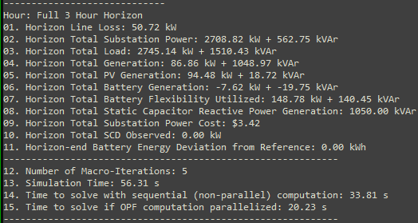
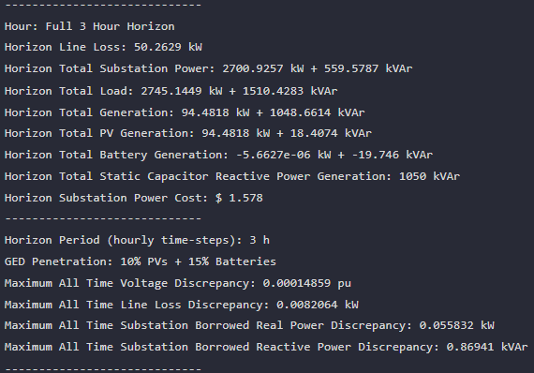

MPDOPF Verified for $T=3, PV=10\%, Batt=15\%$
strLoadShapeCost = 'New Loadshape.LoadShapeCost npts =3 interval = 1 mult = [0.048204 0.048204 0.30181]'
OpenDSS Def Profiles
Gen Cost
MPDOPF Simulation Results
OpenDSS Powerflow Results
Timings
Discrepancies

Slide 22
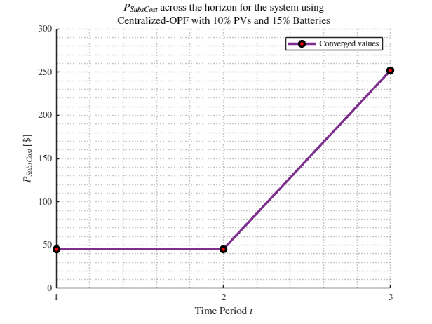
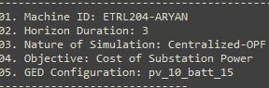
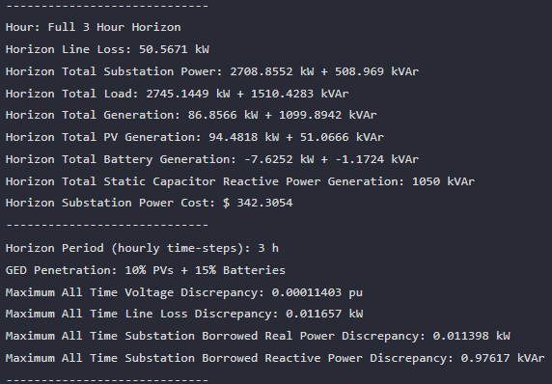
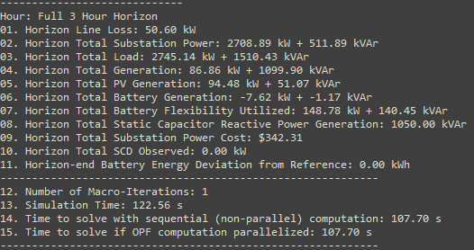

MPCOPF Verified for $T=3, PV=10\%, Batt=15\%$
strLoadShapeCost = 'New Loadshape.LoadShapeCost npts =3 interval = 1 mult = [0.048204 0.048204 0.30181]'
OpenDSS Def Profiles
Gen Cost
MPDOPF Simulation Results
OpenDSS Powerflow Results
Timings
Discrepancies

Slide 23
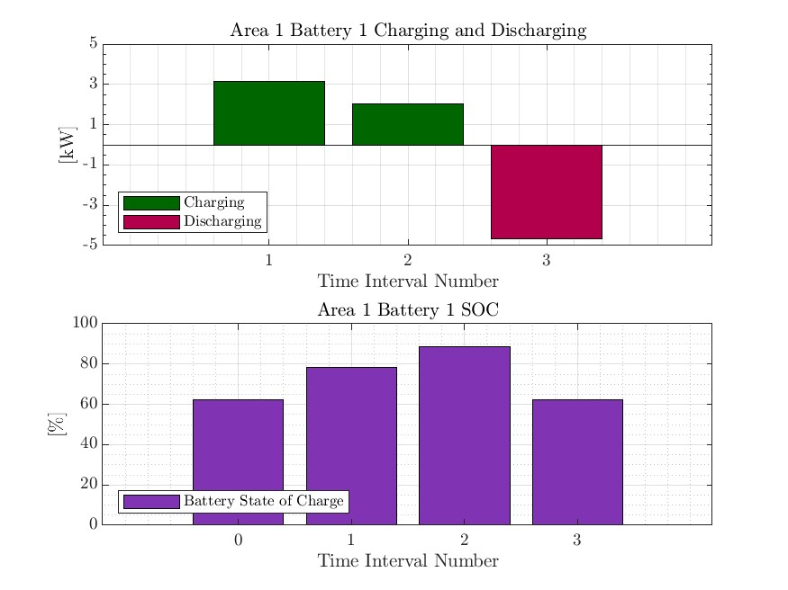
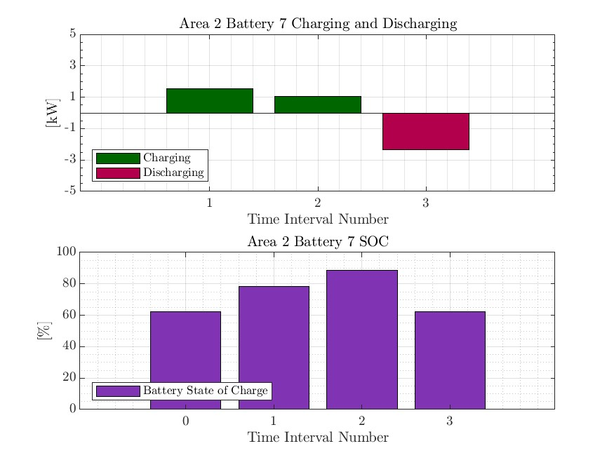
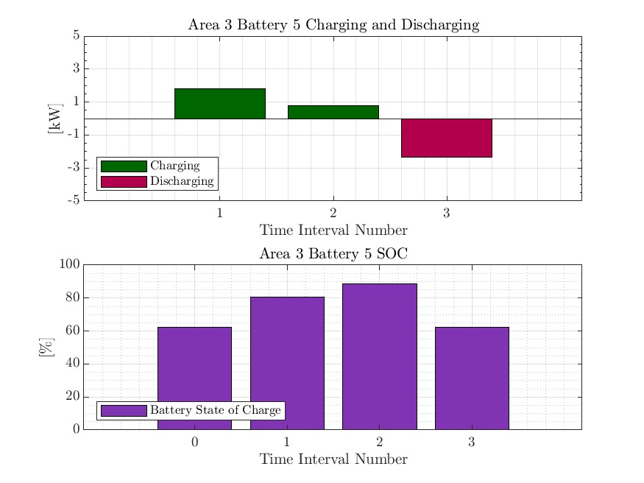
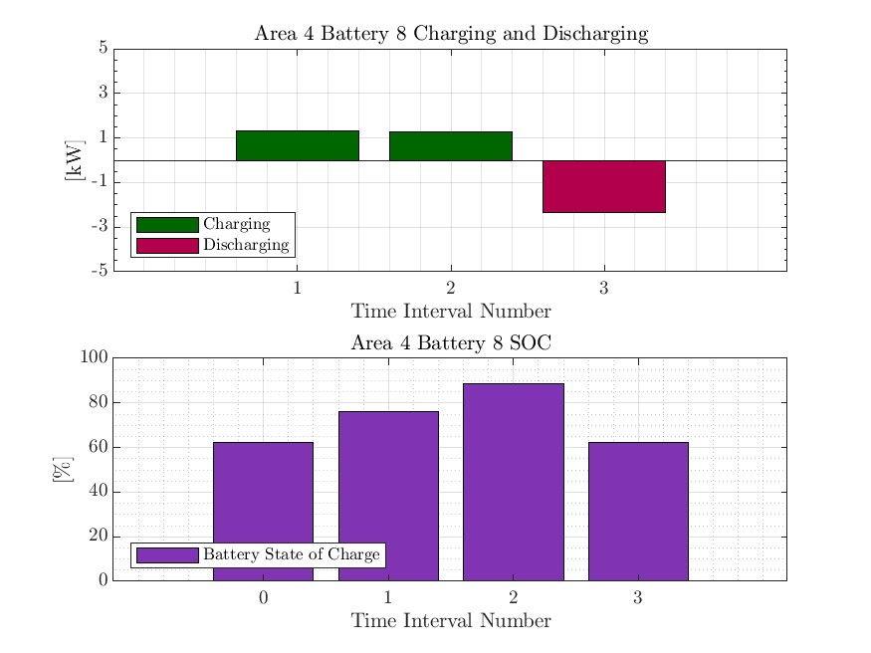

MPDOPF Verified for $T=3, PV=10\%, Batt=15\%$
strLoadShapeCost = 'New Loadshape.LoadShapeCost npts =3 interval = 1 mult = [0.048204 0.048204 0.30181]'
OpenDSS Def Profiles
Gen Cost

Slide 24
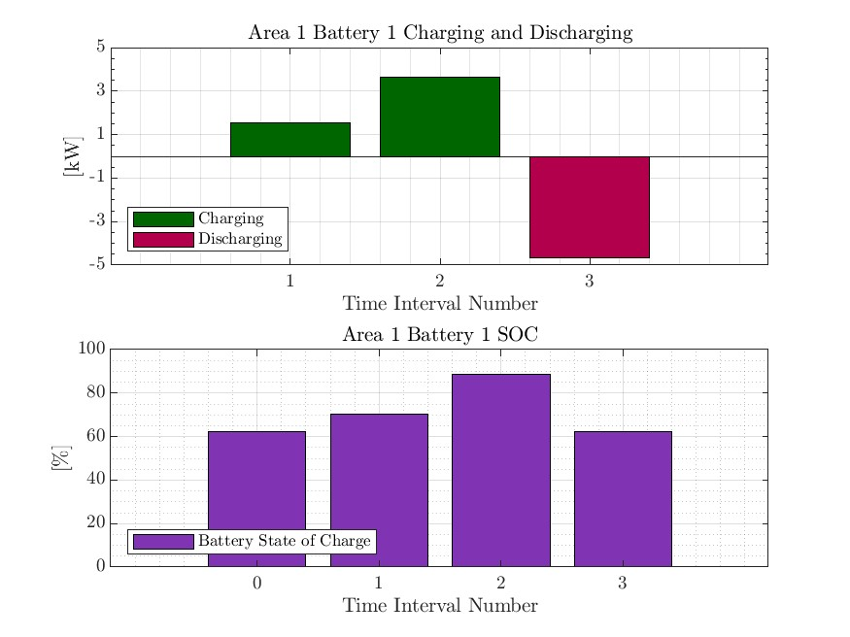

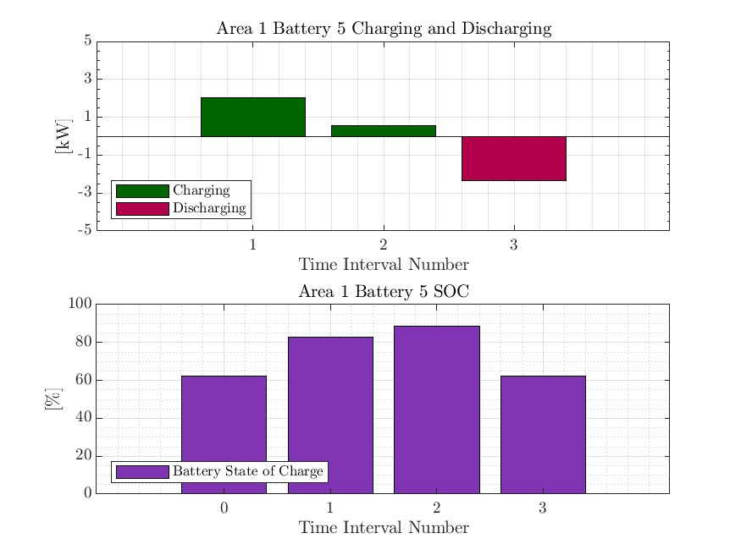


MPCOPF Verified for $T=3, PV=10\%, Batt=15\%$
strLoadShapeCost = 'New Loadshape.LoadShapeCost npts =3 interval = 1 mult = [0.048204 0.048204 0.30181]'
OpenDSS Def Profiles
Gen Cost

Slide 25






MPDOPF Verified for $T=3, PV=10\%, Batt=15\%$
strLoadShapeCost = 'New Loadshape.LoadShapeCost npts =3 interval = 1 mult = [0.048204 0.048204 0.30181]'
$P_{Subs}^{t}$
$P_{SubsCost}^{t}$
OpenDSS Def Profiles
Gen Cost + Peak Shave
OpenDSS Powerflow Results
$$P_{Loss}^{t}$$
MPDOPF Simulation Results
Timings
Discrepancies

Slide 26




MPCOPF Verified for $T=3, PV=10\%, Batt=15\%$
strLoadShapeCost = 'New Loadshape.LoadShapeCost npts =3 interval = 1 mult = [0.048204 0.048204 0.30181]'
OpenDSS Def Profiles
Gen Cost + Peak Shave
MPDOPF Simulation Results
OpenDSS Powerflow Results
Timings
Discrepancies

Slide 27
MPDOPF Verified for $T=3, PV=10\%, Batt=15\%$
strLoadShapeCost = 'New Loadshape.LoadShapeCost npts =3 interval = 1 mult = [0.048204 0.048204 0.30181]'
OpenDSS Def Profiles
Gen Cost + Peak Shave

Slide 28




MPCOPF Verified for $T=3, PV=10\%, Batt=15\%$
strLoadShapeCost = 'New Loadshape.LoadShapeCost npts =3 interval = 1 mult = [0.048204 0.048204 0.30181]'
OpenDSS Def Profiles
Gen Cost + Peak Shave

Slide 29






MPDOPF Verified for $T=5, PV=10\%, Batt=15\%$
strLoadShapeCost = 'New Loadshape.LoadShapeCost npts =5 interval = 1 mult = [0.048204 0.048204 0.30181 0.30181 0.048204]'
$P_{Subs}^{t}$
$P_{SubsCost}^{t}$
OpenDSS Def Profiles
Line Losses
OpenDSS Powerflow Results
$$P_{Loss}^{t}$$
MPDOPF Simulation Results
Objective
$$P_{SubsPeak}$$
Timings
Discrepancies

Slide 30







MPCOPF Verified for $T=5, PV=10\%, Batt=15\%$
strLoadShapeCost = 'New Loadshape.LoadShapeCost npts =5 interval = 1 mult = [0.048204 0.048204 0.30181 0.30181 0.048204]'
$P_{Subs}^{t}$
$P_{SubsCost}^{t}$
OpenDSS Def Profiles
Line Losses
OpenDSS Powerflow Results
$$P_{Loss}^{t}$$
MPDOPF Simulation Results
Objective
$$P_{SubsPeak}$$
Discrepancies
Timings

Slide 31

MPDOPF Verified for $T=5, PV=10\%, Batt=15\%$
strLoadShapeCost = 'New Loadshape.LoadShapeCost npts =5 interval = 1 mult = [0.048204 0.048204 0.30181 0.30181 0.048204]'
OpenDSS Def Profiles
Line Losses

Slide 32

MPCOPF Verified for $T=5, PV=10\%, Batt=15\%$
strLoadShapeCost = 'New Loadshape.LoadShapeCost npts =5 interval = 1 mult = [0.048204 0.048204 0.30181 0.30181 0.048204]'
OpenDSS Def Profiles
Line Losses

Slide 33
MPDOPF Verified for $T=5, PV=10\%, Batt=15\%$
strLoadShapeCost = 'New Loadshape.LoadShapeCost npts =5 interval = 1 mult = [0.048204 0.048204 0.30181 0.30181 0.048204]'
$P_{Subs}^{t}$
$P_{SubsCost}^{t}$
OpenDSS Def Profiles
Line Losses + Peak Shave
OpenDSS Powerflow Results
$$P_{Loss}^{t}$$
MPDOPF Simulation Results
Objective
$$P_{SubsPeak}$$
Timings
Discrepancies

Slide 34
MPCOPF Verified for $T=5, PV=10\%, Batt=15\%$
strLoadShapeCost = 'New Loadshape.LoadShapeCost npts =5 interval = 1 mult = [0.048204 0.048204 0.30181 0.30181 0.048204]'
$P_{Subs}^{t}$
$P_{SubsCost}^{t}$
OpenDSS Def Profiles
Line Losses + Peak Shave
OpenDSS Powerflow Results
$$P_{Loss}^{t}$$
MPDOPF Simulation Results
Objective
$$P_{SubsPeak}$$
Timings
Discrepancies

Slide 35
MPDOPF Verified for $T=5, PV=10\%, Batt=15\%$
strLoadShapeCost = 'New Loadshape.LoadShapeCost npts =5 interval = 1 mult = [0.048204 0.048204 0.30181 0.30181 0.048204]'
OpenDSS Def Profiles
Line Losses + Peak Shave

Slide 36
MPCOPF Verified for $T=5, PV=10\%, Batt=15\%$
strLoadShapeCost = 'New Loadshape.LoadShapeCost npts =5 interval = 1 mult = [0.048204 0.048204 0.30181 0.30181 0.048204]'
OpenDSS Def Profiles
Line Losses + Peak Shave

Slide 37






MPDOPF Verified for $T=5, PV=10\%, Batt=15\%$
strLoadShapeCost = 'New Loadshape.LoadShapeCost npts =5 interval = 1 mult = [0.048204 0.048204 0.30181 0.30181 0.048204]'
$P_{Subs}^{t}$
$P_{SubsCost}^{t}$
OpenDSS Def Profiles
Gen Cost
OpenDSS Powerflow Results
$$P_{Loss}^{t}$$
MPDOPF Simulation Results
Objective
$$P_{SubsPeak}$$
Timings
Discrepancies

Slide 38






MPCOPF Verified for $T=5, PV=10\%, Batt=15\%$
strLoadShapeCost = 'New Loadshape.LoadShapeCost npts =5 interval = 1 mult = [0.048204 0.048204 0.30181 0.30181 0.048204]'
$P_{Subs}^{t}$
$P_{SubsCost}^{t}$
OpenDSS Def Profiles
Gen Cost
OpenDSS Powerflow Results
$$P_{Loss}^{t}$$
MPDOPF Simulation Results
Objective
$$P_{SubsPeak}$$
Timings
Discrepancies

Slide 39




MPDOPF Verified for $T=5, PV=10\%, Batt=15\%$
strLoadShapeCost = 'New Loadshape.LoadShapeCost npts =5 interval = 1 mult = [0.048204 0.048204 0.30181 0.30181 0.048204]'
OpenDSS Def Profiles
Gen Cost

Slide 40




MPCOPF Verified for $T=5, PV=10\%, Batt=15\%$
strLoadShapeCost = 'New Loadshape.LoadShapeCost npts =5 interval = 1 mult = [0.048204 0.048204 0.30181 0.30181 0.048204]'
OpenDSS Def Profiles
Gen Cost

Slide 41






MPDOPF Verified for $T=5, PV=10\%, Batt=15\%$
strLoadShapeCost = 'New Loadshape.LoadShapeCost npts =5 interval = 1 mult = [0.048204 0.048204 0.30181 0.30181 0.048204]'
$P_{Subs}^{t}$
$P_{SubsCost}^{t}$
OpenDSS Def Profiles
Gen Cost + Peak Shave
OpenDSS Powerflow Results
$$P_{Loss}^{t}$$
MPDOPF Simulation Results
Timings
Discrepancies

Slide 42






MPCOPF Verified for $T=5, PV=10\%, Batt=15\%$
strLoadShapeCost = 'New Loadshape.LoadShapeCost npts =5 interval = 1 mult = [0.048204 0.048204 0.30181 0.30181 0.048204]'
$P_{Subs}^{t}$
$P_{SubsCost}^{t}$
OpenDSS Def Profiles
Gen Cost + Peak Shave
OpenDSS Powerflow Results
$$P_{Loss}^{t}$$
MPDOPF Simulation Results
Discrepancies
Timings

Slide 43




MPDOPF Verified for $T=5, PV=10\%, Batt=15\%$
strLoadShapeCost = 'New Loadshape.LoadShapeCost npts =5 interval = 1 mult = [0.048204 0.048204 0.30181 0.30181 0.048204]'
OpenDSS Def Profiles
Gen Cost + Peak Shave

Slide 44




MPCOPF Verified for $T=5, PV=10\%, Batt=15\%$
strLoadShapeCost = 'New Loadshape.LoadShapeCost npts =5 interval = 1 mult = [0.048204 0.048204 0.30181 0.30181 0.048204]'
OpenDSS Def Profiles
Gen Cost + Peak Shave

Slide 45







MPDOPF Verified for $T=12, PV=10\%, Batt=15\%$
$P_{Subs}^{t}$
$P_{SubsCost}^{t}$
OpenDSS Def Profiles
Gen Cost + Peak Shave
OpenDSS Powerflow Results
$$P_{Loss}^{t}$$
MPDOPF Simulation Results
Objective
$$P_{SubsPeak}$$
Timings
Discrepancies

Slide 46

MPCOPF Verified for $T=12, PV=10\%, Batt=15\%$
$P_{Subs}^{t}$
$P_{SubsCost}^{t}$
OpenDSS Def Profiles
Gen Cost + Peak Shave
OpenDSS Powerflow Results
$$P_{Loss}^{t}$$
MPDOPF Simulation Results
Timings
Discrepancies

Slide 47





MPDOPF Verified for $T=12, PV=10\%, Batt=15\%$
OpenDSS Def Profiles
Gen Cost + Peak Shave

Slide 48

MPCOPF Verified for $T=12, PV=10\%, Batt=15\%$
OpenDSS Def Profiles
Gen Cost + Peak Shave

Slide 49
MPDOPF Verified for $T=3, PV=10\%, Batt=15\%$
strLoadShape = 'New Loadshape.LoadShape npts =3 interval = 1 mult = [0.777 0.787 0.796]'
strLoadShapePV = 'New Loadshape.LoadShapePV npts =3 interval = 1 mult = [0.8 0.9 1]'
$P_{Subs}^{t}$
$P_{SubsCost}^{t}$
OpenDSS Def Profiles
Gen Cost + Peak Shave
OpenDSS Powerflow Results
$$P_{Loss}^{t}$$
MPDOPF Simulation Results
Timings
Discrepancies

Slide 50
MPCOPF Verified for $T=3, PV=10\%, Batt=15\%$
$P_{Subs}^{t}$
$P_{SubsCost}^{t}$
OpenDSS Def Profiles
Gen Cost + Peak Shave
OpenDSS Powerflow Results
$$P_{Loss}^{t}$$
MPDOPF Simulation Results
Timings
Discrepancies

Slide 51
MPDOPF Verified for $T=3, PV=10\%, Batt=15\%$
OpenDSS Def Profiles
Gen Cost + Peak Shave

Slide 52
MPCOPF Verified for $T=3, PV=10\%, Batt=15\%$
OpenDSS Def Profiles
Gen Cost + Peak Shave

Slide 53





MPDOPF Verified for $T=2, PV=10\%, Batt=15\%$
strLoadShape = 'New Loadshape.LoadShape npts =2 interval = 1 mult = [1 0.7]'
strLoadShapePV = 'New Loadshape.LoadShapePV npts =2 interval = 1 mult = [1.4 0.8]'
MPDOPF Simulation Results
Alternative Profiles
OpenDSS Powerflow Results

Slide 54





MPCOPF Verified for $T=2, PV=10\%, Batt=15\%$
strLoadShape = 'New Loadshape.LoadShape npts =2 interval = 1 mult = [1 0.7]'
strLoadShapePV = 'New Loadshape.LoadShapePV npts =2 interval = 1 mult = [1.4 0.8]'
MPCOPF Simulation Results
Alternative Profiles
OpenDSS Powerflow Results

Slide 55





MPDOPF Verified for $T=2, PV=10\%, Batt=15\%$
strLoadShape = 'New Loadshape.LoadShape npts =2 interval = 1 mult = [1 0.7]'
strLoadShapePV = 'New Loadshape.LoadShapePV npts =2 interval = 1 mult = [1.4 0.8]'
Alternative Profiles

Slide 56




MPCOPF Verified for $T=2, PV=10\%, Batt=15\%$
strLoadShape = 'New Loadshape.LoadShape npts =2 interval = 1 mult = [1 0.7]'
strLoadShapePV = 'New Loadshape.LoadShapePV npts =2 interval = 1 mult = [1.4 0.8]'
Alternative Profiles

Slide 57




Boundary Complex Powers
strLoadShape = 'New Loadshape.LoadShape npts =2 interval = 1 mult = [1 0.7]'
MPDOPF Verified for $T=2, PV=10\%, Batt=15\%$
strLoadShapePV = 'New Loadshape.LoadShapePV npts =2 interval = 1 mult = [1.4 0.8]'
Alternative Profiles

Slide 58



Boundary Voltages
strLoadShape = 'New Loadshape.LoadShape npts =2 interval = 1 mult = [1 0.7]'
MPDOPF Verified for $T=2, PV=10\%, Batt=15\%$
strLoadShapePV = 'New Loadshape.LoadShapePV npts =2 interval = 1 mult = [1.4 0.8]'
Alternative Profiles

Slide 59



MPDOPF Verified for $T=3, PV=10\%, Batt=15\%$
strLoadShape = 'New Loadshape.LoadShape npts =3 interval = 1 mult = [0.777 0.787 0.796]'
strLoadShapePV = 'New Loadshape.LoadShapePV npts =3 interval = 1 mult = [0.8 0.9 1]'
MPDOPF Simulation Results
OpenDSS Powerflow Results
OpenDSS Def Profiles

Slide 60
MPCOPF Verified for $T=3, PV=10\%, Batt=15\%$
strLoadShape = 'New Loadshape.LoadShape npts =3 interval = 1 mult = [0.777 0.787 0.796]'
strLoadShapePV = 'New Loadshape.LoadShapePV npts =3 interval = 1 mult = [0.8 0.9 1]'
MPDOPF Simulation Results
OpenDSS Powerflow Results
OpenDSS Def Profiles

Slide 61



MPDOPF Verified for $T=3, PV=10\%, Batt=15\%$
strLoadShape = 'New Loadshape.LoadShape npts =3 interval = 1 mult = [0.777 0.787 0.796]'
strLoadShapePV = 'New Loadshape.LoadShapePV npts =3 interval = 1 mult = [0.8 0.9 1]'
OpenDSS Def Profiles

Slide 62
MPCOPF Verified for $T=3, PV=10\%, Batt=15\%$
strLoadShape = 'New Loadshape.LoadShape npts =3 interval = 1 mult = [0.777 0.787 0.796]'
strLoadShapePV = 'New Loadshape.LoadShapePV npts =3 interval = 1 mult = [0.8 0.9 1]'
OpenDSS Def Profiles

Slide 63




Boundary Complex Powers
strLoadShape = 'New Loadshape.LoadShape npts =3 interval = 1 mult = [0.777 0.787 0.796]'
MPDOPF Verified for $T=3, PV=10\%, Batt=15\%$
strLoadShapePV = 'New Loadshape.LoadShapePV npts =3 interval = 1 mult = [0.8 0.9 1]'
OpenDSS Def Profiles

Slide 64



Boundary Voltages
strLoadShape = 'New Loadshape.LoadShape npts =3 interval = 1 mult = [0.777 0.787 0.796]'
MPDOPF Verified for $T=3, PV=10\%, Batt=15\%$
strLoadShapePV = 'New Loadshape.LoadShapePV npts =3 interval = 1 mult = [0.8 0.9 1]'
OpenDSS Def Profiles

Slide 65




MPDOPF Verified for $T=3, PV=10\%, Batt=15\%$
strLoadShape = 'New Loadshape.LoadShape npts =3 interval = 1 mult = [0.7 1 0.7]'
strLoadShapePV = 'New Loadshape.LoadShapePV npts =3 interval = 1 mult = [0.8 1 0.8]'
MPDOPF Simulation Results
Alternative Profiles
OpenDSS Powerflow Results

Slide 66





MPCOPF Verified for $T=3, PV=10\%, Batt=15\%$
strLoadShape = 'New Loadshape.LoadShape npts =3 interval = 1 mult = [0.7 1 0.7]'
strLoadShapePV = 'New Loadshape.LoadShapePV npts =3 interval = 1 mult = [0.8 1 0.8]'
MPCOPF Simulation Results
Alternative Profiles
OpenDSS Powerflow Results

Slide 67




MPDOPF Verified for $T=3, PV=10\%, Batt=15\%$
strLoadShape = 'New Loadshape.LoadShape npts =3 interval = 1 mult = [0.7 1 0.7]'
strLoadShapePV = 'New Loadshape.LoadShapePV npts =3 interval = 1 mult = [0.8 1 0.8]'
Alternative Profiles

Slide 68



MPCOPF Verified for $T=3, PV=10\%, Batt=15\%$
strLoadShape = 'New Loadshape.LoadShape npts =3 interval = 1 mult = [0.7 1 0.7]'
strLoadShapePV = 'New Loadshape.LoadShapePV npts =3 interval = 1 mult = [0.8 1 0.8]'
Alternative Profiles

Slide 69



Boundary Complex Powers
strLoadShape = 'New Loadshape.LoadShape npts =3 interval = 1 mult = [0.7 1 0.7]'
MPDOPF Verified for $T=3, PV=10\%, Batt=15\%$
strLoadShapePV = 'New Loadshape.LoadShapePV npts =3 interval = 1 mult = [0.8 1 0.8]'
Alternative Profiles

Slide 70



Boundary Voltages
strLoadShape = 'New Loadshape.LoadShape npts =3 interval = 1 mult = [0.7 1 0.7]'
MPDOPF Verified for $T=3, PV=10\%, Batt=15\%$
strLoadShapePV = 'New Loadshape.LoadShapePV npts =3 interval = 1 mult = [0.8 1 0.8]'
Alternative Profiles

Slide 71





MPDOPF Verified for $T=5, PV=10\%, Batt=15\%$
strLoadShape = 'New Loadshape.LoadShape npts =5 interval = 1 mult = [0.75 0.777 0.787 0.796 0.782]'
strLoadShapePV = 'New Loadshape.LoadShapePV npts =5 interval = 1 mult = [0.5 0.8 0.9 1 1]'
MPDOPF Simulation Results
OpenDSS Powerflow Results

Slide 72





MPCOPF Verified for $T=5, PV=10\%, Batt=15\%$
strLoadShape = 'New Loadshape.LoadShape npts =5 interval = 1 mult = [0.75 0.777 0.787 0.796 0.782]'
strLoadShapePV = 'New Loadshape.LoadShapePV npts =5 interval = 1 mult = [0.5 0.8 0.9 1 1]'
MPCOPF Simulation Results
OpenDSS Powerflow Results

Slide 73




Boundary Complex Powers
MPDOPF Verified for $T=5, PV=10\%, Batt=15\%$

Slide 74



Boundary Voltages
MPDOPF Verified for $T=5, PV=10\%, Batt=15\%$

Slide 75




MPDOPF Verified for $T=5, PV=10\%, Batt=15\%$
strLoadShape = 'New Loadshape.LoadShape npts =5 interval = 1 mult = [0.7 0.85 1 0.85 0.7]'
strLoadShapePV = 'New Loadshape.LoadShapePV npts =5 interval = 1 mult = [1 1.2828 1.4 1.1 0.8]'
MPDOPF Simulation Results
Alternative Profiles
OpenDSS Powerflow Results

Slide 76




MPCOPF Verified for $T=5, PV=10\%, Batt=15\%$
strLoadShape = 'New Loadshape.LoadShape npts =5 interval = 1 mult = [0.7 0.85 1 0.85 0.7]'
strLoadShapePV = 'New Loadshape.LoadShapePV npts =5 interval = 1 mult = [1 1.2828 1.4 1.1 0.8]'
MPCOPF Simulation Results
Alternative Profiles
OpenDSS Powerflow Results

Slide 77




MPDOPF Verified for $T=5, PV=10\%, Batt=15\%$
strLoadShape = 'New Loadshape.LoadShape npts =5 interval = 1 mult = [0.7 0.85 1 0.85 0.7]'
strLoadShapePV = 'New Loadshape.LoadShapePV npts =5 interval = 1 mult = [1 1.2828 1.4 1.1 0.8]'
Alternative Profiles

Slide 78




MPCOPF Verified for $T=5, PV=10\%, Batt=15\%$
strLoadShape = 'New Loadshape.LoadShape npts =5 interval = 1 mult = [0.7 0.85 1 0.85 0.7]'
strLoadShapePV = 'New Loadshape.LoadShapePV npts =5 interval = 1 mult = [1 1.2828 1.4 1.1 0.8]'
Alternative Profiles

Slide 79



Boundary Complex Powers
strLoadShape = 'New Loadshape.LoadShape npts =5 interval = 1 mult = [0.7 0.85 1 0.85 0.7]'
MPDOPF Verified for $T=5, PV=10\%, Batt=15\%$
strLoadShapePV = 'New Loadshape.LoadShapePV npts =5 interval = 1 mult = [1 1.2828 1.4 1.1 0.8]'
Alternative Profiles

Slide 80



Boundary Voltages
strLoadShape = 'New Loadshape.LoadShape npts =5 interval = 1 mult = [0.7 0.85 1 0.85 0.7]'
MPDOPF Verified for $T=5, PV=10\%, Batt=15\%$
strLoadShapePV = 'New Loadshape.LoadShapePV npts =5 interval = 1 mult = [1 1.2828 1.4 1.1 0.8]'
Alternative Profiles

Slide 81


MPDOPF Verified for $T=8, PV=10\%, Batt=15\%$
strLoadShape = 'New Loadshape.LoadShape npts =8 interval = 1 mult = [0.705 0.75 0.777 0.787 0.796 0.782 0.783 0.789]'
strLoadShapePV = 'New Loadshape.LoadShapePV npts =8 interval = 1 mult = [0.3 0.5 0.8 0.9 1 1 0.99 0.9]'
MPDOPF Simulation Results
OpenDSS Powerflow Results

Slide 82





MPCOPF Verified for $T=8, PV=10\%, Batt=15\%$
strLoadShape = 'New Loadshape.LoadShape npts =8 interval = 1 mult = [0.705 0.75 0.777 0.787 0.796 0.782 0.783 0.789]'
strLoadShapePV = 'New Loadshape.LoadShapePV npts =8 interval = 1 mult = [0.3 0.5 0.8 0.9 1 1 0.99 0.9]'
MPCOPF Simulation Results
OpenDSS Powerflow Results

Slide 83

MPDOPF Verified for $T=8, PV=10\%, Batt=15\%$
strLoadShape = 'New Loadshape.LoadShape npts =8 interval = 1 mult = [0.705 0.75 0.777 0.787 0.796 0.782 0.783 0.789]'
1, 5, 7, 8 in COPF values
strLoadShapePV = 'New Loadshape.LoadShapePV npts =8 interval = 1 mult = [0.3 0.5 0.8 0.9 1 1 0.99 0.9]'

Slide 84





MPCOPF Verified for $T=8, PV=10\%, Batt=15\%$
strLoadShape = 'New Loadshape.LoadShape npts =8 interval = 1 mult = [0.705 0.75 0.777 0.787 0.796 0.782 0.783 0.789]'
strLoadShapePV = 'New Loadshape.LoadShapePV npts =8 interval = 1 mult = [0.3 0.5 0.8 0.9 1 1 0.99 0.9]'

Slide 85




Boundary Complex Powers
strLoadShape = 'New Loadshape.LoadShape npts =8 interval = 1 mult = [0.705 0.75 0.777 0.787 0.796 0.782 0.783 0.789]'
MPDOPF Verified for $T=8, PV=10\%, Batt=15\%$
strLoadShapePV = 'New Loadshape.LoadShapePV npts =8 interval = 1 mult = [0.3 0.5 0.8 0.9 1 1 0.99 0.9]'

Slide 86



Boundary Voltages
strLoadShape = 'New Loadshape.LoadShape npts =8 interval = 1 mult = [0.705 0.75 0.777 0.787 0.796 0.782 0.783 0.789]'
MPDOPF Verified for $T=8, PV=10\%, Batt=15\%$
strLoadShapePV = 'New Loadshape.LoadShapePV npts =8 interval = 1 mult = [0.3 0.5 0.8 0.9 1 1 0.99 0.9]'

Slide 87





MPDOPF Verified for $T=9, PV=10\%, Batt=15\%$
strLoadShape = 'New Loadshape.LoadShape npts =9 interval = 1 mult = [0.668 0.705 0.75 0.777 0.787 0.796 0.782 0.783 0.789]'
strLoadShapePV = 'New Loadshape.LoadShapePV npts =9 interval = 1 mult = [0.2 0.3 0.5 0.8 0.9 1 1 0.99 0.9]'
MPDOPF Simulation Results
OpenDSS Powerflow Results

Slide 88





MPCOPF Verified for $T=9, PV=10\%, Batt=15\%$
strLoadShape = 'New Loadshape.LoadShape npts =9 interval = 1 mult = [0.668 0.705 0.75 0.777 0.787 0.796 0.782 0.783 0.789]'
strLoadShapePV = 'New Loadshape.LoadShapePV npts =9 interval = 1 mult = [0.2 0.3 0.5 0.8 0.9 1 1 0.99 0.9]'
MPCOPF Simulation Results
OpenDSS Powerflow Results

Slide 89








MPDOPF Verified for $T=9, PV=10\%, Batt=15\%$
strLoadShape = 'New Loadshape.LoadShape npts =9 interval = 1 mult = [0.668 0.705 0.75 0.777 0.787 0.796 0.782 0.783 0.789]'
strLoadShapePV = 'New Loadshape.LoadShapePV npts =9 interval = 1 mult = [0.2 0.3 0.5 0.8 0.9 1 1 0.99 0.9]'

Slide 90








MPCOPF Verified for $T=9, PV=10\%, Batt=15\%$
strLoadShape = 'New Loadshape.LoadShape npts =9 interval = 1 mult = [0.668 0.705 0.75 0.777 0.787 0.796 0.782 0.783 0.789]'
strLoadShapePV = 'New Loadshape.LoadShapePV npts =9 interval = 1 mult = [0.2 0.3 0.5 0.8 0.9 1 1 0.99 0.9]'

Slide 91




Boundary Complex Powers
strLoadShape = 'New Loadshape.LoadShape npts =9 interval = 1 mult = [0.668 0.705 0.75 0.777 0.787 0.796 0.782 0.783 0.789]'
MPDOPF Verified for $T=9, PV=10\%, Batt=15\%$
strLoadShapePV = 'New Loadshape.LoadShapePV npts =9 interval = 1 mult = [0.2 0.3 0.5 0.8 0.9 1 1 0.99 0.9]'

Slide 92



Boundary Voltages
strLoadShape = 'New Loadshape.LoadShape npts =9 interval = 1 mult = [0.668 0.705 0.75 0.777 0.787 0.796 0.782 0.783 0.789]'
MPDOPF Verified for $T=9, PV=10\%, Batt=15\%$
strLoadShapePV = 'New Loadshape.LoadShapePV npts =9 interval = 1 mult = [0.2 0.3 0.5 0.8 0.9 1 1 0.99 0.9]'

Slide 93





MPDOPF Verified for $T=10, PV=10\%, Batt=15\%$
strLoadShape = 'New Loadshape.LoadShape npts =10 interval = 1 mult = [0.668 0.705 0.75 0.777 0.787 0.796 0.782 0.783 0.789 0.826]'
strLoadShapePV = 'New Loadshape.LoadShapePV npts =10 interval = 1 mult = [0.2 0.3 0.5 0.8 0.9 1 1 0.99 0.9 0.7]'
MPDOPF Simulation Results
OpenDSS Powerflow Results

Slide 94





MPCOPF Verified for $T=10, PV=10\%, Batt=15\%$
strLoadShape = 'New Loadshape.LoadShape npts =10 interval = 1 mult = [0.668 0.705 0.75 0.777 0.787 0.796 0.782 0.783 0.789 0.826]'
strLoadShapePV = 'New Loadshape.LoadShapePV npts =10 interval = 1 mult = [0.2 0.3 0.5 0.8 0.9 1 1 0.99 0.9 0.7]'
MPCOPF Simulation Results
OpenDSS Powerflow Results

Slide 95





MPDOPF Verified for $T=10, PV=10\%, Batt=15\%$
strLoadShape = 'New Loadshape.LoadShape npts =10 interval = 1 mult = [0.668 0.705 0.75 0.777 0.787 0.796 0.782 0.783 0.789 0.826]'
strLoadShapePV = 'New Loadshape.LoadShapePV npts =10 interval = 1 mult = [0.2 0.3 0.5 0.8 0.9 1 1 0.99 0.9 0.7]'

Slide 96





MPCOPF Verified for $T=10, PV=10\%, Batt=15\%$
strLoadShape = 'New Loadshape.LoadShape npts =10 interval = 1 mult = [0.668 0.705 0.75 0.777 0.787 0.796 0.782 0.783 0.789 0.826]'
strLoadShapePV = 'New Loadshape.LoadShapePV npts =10 interval = 1 mult = [0.2 0.3 0.5 0.8 0.9 1 1 0.99 0.9 0.7]'

Slide 97




Boundary Complex Powers
MPDOPF Verified for $T=10, PV=10\%, Batt=15\%$

Slide 98



Boundary Voltages
MPDOPF Verified for $T=10, PV=10\%, Batt=15\%$

Slide 99





MPDOPF Verified for $T=11, PV=10\%, Batt=15\%$
strLoadShape = 'New Loadshape.LoadShape npts =11 interval = 1 mult = [0.644 0.668 0.705 0.75 0.777 0.787 0.796 0.782 0.783 0.789 0.826]'
strLoadShapePV = 'New Loadshape.LoadShapePV npts =11 interval = 1 mult = [0.1 0.2 0.3 0.5 0.8 0.9 1 1 0.99 0.9 0.7]'
MPDOPF Simulation Results
OpenDSS Powerflow Results
OpenDSS Def Profiles

Slide 100

MPCOPF Verified for $T=11, PV=10\%, Batt=15\%$
strLoadShape = 'New Loadshape.LoadShape npts =11 interval = 1 mult = [0.644 0.668 0.705 0.75 0.777 0.787 0.796 0.782 0.783 0.789 0.826]'
strLoadShapePV = 'New Loadshape.LoadShapePV npts =11 interval = 1 mult = [0.1 0.2 0.3 0.5 0.8 0.9 1 1 0.99 0.9 0.7]'
MPDOPF Simulation Results
OpenDSS Powerflow Results
OpenDSS Def Profiles

Slide 101





MPDOPF Verified for $T=11, PV=10\%, Batt=15\%$
strLoadShape = 'New Loadshape.LoadShape npts =11 interval = 1 mult = [0.644 0.668 0.705 0.75 0.777 0.787 0.796 0.782 0.783 0.789 0.826]'
strLoadShapePV = 'New Loadshape.LoadShapePV npts =11 interval = 1 mult = [0.1 0.2 0.3 0.5 0.8 0.9 1 1 0.99 0.9 0.7]'
OpenDSS Def Profiles

Slide 102

MPCOPF Verified for $T=11, PV=10\%, Batt=15\%$
strLoadShape = 'New Loadshape.LoadShape npts =11 interval = 1 mult = [0.644 0.668 0.705 0.75 0.777 0.787 0.796 0.782 0.783 0.789 0.826]'
strLoadShapePV = 'New Loadshape.LoadShapePV npts =11 interval = 1 mult = [0.1 0.2 0.3 0.5 0.8 0.9 1 1 0.99 0.9 0.7]'
OpenDSS Def Profiles

Slide 103




Boundary Complex Powers
strLoadShape = 'New Loadshape.LoadShape npts =11 interval = 1 mult = [0.644 0.668 0.705 0.75 0.777 0.787 0.796 0.782 0.783 0.789 0.826]'
MPDOPF Verified for $T=11, PV=10\%, Batt=15\%$
strLoadShapePV = 'New Loadshape.LoadShapePV npts =11 interval = 1 mult = [0.1 0.2 0.3 0.5 0.8 0.9 1 1 0.99 0.9 0.7]'
OpenDSS Def Profiles

Slide 104



Boundary Voltages
strLoadShape = 'New Loadshape.LoadShape npts =11 interval = 1 mult = [0.644 0.668 0.705 0.75 0.777 0.787 0.796 0.782 0.783 0.789 0.826]'
MPDOPF Verified for $T=11, PV=10\%, Batt=15\%$
strLoadShapePV = 'New Loadshape.LoadShapePV npts =11 interval = 1 mult = [0.1 0.2 0.3 0.5 0.8 0.9 1 1 0.99 0.9 0.7]'
OpenDSS Def Profiles

Slide 105




MPDOPF Verified for $T=12, PV=10\%, Batt=15\%$
strLoadShape = 'New Loadshape.LoadShape npts =12 interval = 1 mult = [0.644 0.668 0.705 0.75 0.777 0.787 0.796 0.782 0.783 0.789 0.826 0.855]'
strLoadShapePV = 'New Loadshape.LoadShapePV npts =12 interval = 1 mult = [0.1 0.2 0.3 0.5 0.8 0.9 1 1 0.99 0.9 0.7 0.4]'
MPDOPF Simulation Results
OpenDSS Powerflow Results
OpenDSS Def Profiles

Slide 106




MPCOPF Verified for $T=12, PV=10\%, Batt=15\%$
strLoadShape = 'New Loadshape.LoadShape npts =12 interval = 1 mult = [0.644 0.668 0.705 0.75 0.777 0.787 0.796 0.782 0.783 0.789 0.826 0.855]'
strLoadShapePV = 'New Loadshape.LoadShapePV npts =12 interval = 1 mult = [0.1 0.2 0.3 0.5 0.8 0.9 1 1 0.99 0.9 0.7 0.4]'
MPDOPF Simulation Results
OpenDSS Powerflow Results
OpenDSS Def Profiles

Slide 107




MPDOPF Verified for $T=12, PV=10\%, Batt=15\%$
strLoadShape = 'New Loadshape.LoadShape npts =12 interval = 1 mult = [0.644 0.668 0.705 0.75 0.777 0.787 0.796 0.782 0.783 0.789 0.826 0.855]'
strLoadShapePV = 'New Loadshape.LoadShapePV npts =12 interval = 1 mult = [0.1 0.2 0.3 0.5 0.8 0.9 1 1 0.99 0.9 0.7 0.4]'
OpenDSS Def Profiles

Slide 108
MPCOPF Verified for $T=12, PV=10\%, Batt=15\%$
strLoadShape = 'New Loadshape.LoadShape npts =12 interval = 1 mult = [0.644 0.668 0.705 0.75 0.777 0.787 0.796 0.782 0.783 0.789 0.826 0.855]'
strLoadShapePV = 'New Loadshape.LoadShapePV npts =12 interval = 1 mult = [0.1 0.2 0.3 0.5 0.8 0.9 1 1 0.99 0.9 0.7 0.4]'
OpenDSS Def Profiles

Slide 109




Boundary Complex Powers
strLoadShape = 'New Loadshape.LoadShape npts =12 interval = 1 mult = [0.644 0.668 0.705 0.75 0.777 0.787 0.796 0.782 0.783 0.789 0.826 0.855]'
MPDOPF Verified for $T=12, PV=10\%, Batt=15\%$
strLoadShapePV = 'New Loadshape.LoadShapePV npts =12 interval = 1 mult = [0.1 0.2 0.3 0.5 0.8 0.9 1 1 0.99 0.9 0.7 0.4]'
OpenDSS Def Profiles

Slide 110



Boundary Voltages
strLoadShape = 'New Loadshape.LoadShape npts =12 interval = 1 mult = [0.644 0.668 0.705 0.75 0.777 0.787 0.796 0.782 0.783 0.789 0.826 0.855]'
MPDOPF Verified for $T=12, PV=10\%, Batt=15\%$
strLoadShapePV = 'New Loadshape.LoadShapePV npts =12 interval = 1 mult = [0.1 0.2 0.3 0.5 0.8 0.9 1 1 0.99 0.9 0.7 0.4]'
OpenDSS Def Profiles

Slide 111





MPDOPF Verified for $T=16, PV=10\%, Batt=15\%$
strLoadShape = 'New Loadshape.LoadShape npts =16 interval = 1 mult = [0.598 0.613 0.644 0.668 0.705 0.75 0.777 0.787 0.796 0.782 0.783 0.789 0.826 0.855 0.95 1]'
strLoadShapePV = 'New Loadshape.LoadShapePV npts =16 interval = 1 mult = [0 0 0.1 0.2 0.3 0.5 0.8 0.9 1 1 0.99 0.9 0.7 0.4 0.1 0]'
MPDOPF Simulation Results
OpenDSS Powerflow Results
OpenDSS Def Profiles

Slide 112





MPDOPF Verified for $T=16, PV=10\%, Batt=15\%$
strLoadShape = 'New Loadshape.LoadShape npts =16 interval = 1 mult = [0.598 0.613 0.644 0.668 0.705 0.75 0.777 0.787 0.796 0.782 0.783 0.789 0.826 0.855 0.95 1]'
strLoadShapePV = 'New Loadshape.LoadShapePV npts =16 interval = 1 mult = [0 0 0.1 0.2 0.3 0.5 0.8 0.9 1 1 0.99 0.9 0.7 0.4 0.1 0]'
OpenDSS Def Profiles

Slide 113




Boundary Complex Powers
strLoadShape = 'New Loadshape.LoadShape npts =16 interval = 1 mult = [0.598 0.613 0.644 0.668 0.705 0.75 0.777 0.787 0.796 0.782 0.783 0.789 0.826 0.855 0.95 1]'
MPDOPF Verified for $T=16, PV=10\%, Batt=15\%$
strLoadShapePV = 'New Loadshape.LoadShapePV npts =16 interval = 1 mult = [0 0 0.1 0.2 0.3 0.5 0.8 0.9 1 1 0.99 0.9 0.7 0.4 0.1 0]'
OpenDSS Def Profiles

Slide 114



Boundary Voltages
strLoadShape = 'New Loadshape.LoadShape npts =16 interval = 1 mult = [0.598 0.613 0.644 0.668 0.705 0.75 0.777 0.787 0.796 0.782 0.783 0.789 0.826 0.855 0.95 1]'
MPDOPF Verified for $T=16, PV=10\%, Batt=15\%$
strLoadShapePV = 'New Loadshape.LoadShapePV npts =16 interval = 1 mult = [0 0 0.1 0.2 0.3 0.5 0.8 0.9 1 1 0.99 0.9 0.7 0.4 0.1 0]'
OpenDSS Def Profiles

Slide 115
MPDOPF Verified for $T=3, PV=10\%, Batt=15\%$
strLoadShape = 'New Loadshape.LoadShape npts =11 interval = 1 mult = [0.644 0.668 0.705 0.75 0.777 0.787 0.796 0.782 0.783 0.789 0.826]'
strLoadShapePV = 'New Loadshape.LoadShapePV npts =11 interval = 1 mult = [0.1 0.2 0.3 0.5 0.8 0.9 1 1 0.99 0.9 0.7]'
MPDOPF Simulation Results
OpenDSS Powerflow Results
OpenDSS Def Profiles

Slide 116
MPCOPF Verified for $T=3, PV=10\%, Batt=15\%$
MPDOPF Simulation Results
OpenDSS Powerflow Results
OpenDSS Def Profiles

Slide 117
MPDOPF Verified for $T=3, PV=10\%, Batt=15\%$
OpenDSS Def Profiles

Slide 118
MPCOPF Verified for $T=3, PV=10\%, Batt=15\%$
OpenDSS Def Profiles

Slide 119
Boundary Complex Powers
MPDOPF Verified for $T=3, PV=10\%, Batt=15\%$
OpenDSS Def Profiles

Slide 120
Boundary Voltages
MPDOPF Verified for $T=3, PV=10\%, Batt=15\%$
OpenDSS Def Profiles

Slide 121
MPDOPF Verified for $T=5, PV=10\%, Batt=15\%$
strLoadShape = 'New Loadshape.LoadShape npts =5 interval = 1 mult = [0.75 0.777 0.787 0.796 0.782]'
strLoadShapePV = 'New Loadshape.LoadShapePV npts =5 interval = 1 mult = [0.5 0.8 0.9 1 1]'
MPDOPF Simulation Results
OpenDSS Powerflow Results

Slide 122
MPCOPF Verified for $T=5, PV=10\%, Batt=15\%$
strLoadShape = 'New Loadshape.LoadShape npts =5 interval = 1 mult = [0.75 0.777 0.787 0.796 0.782]'
strLoadShapePV = 'New Loadshape.LoadShapePV npts =5 interval = 1 mult = [0.5 0.8 0.9 1 1]'
MPCOPF Simulation Results
OpenDSS Powerflow Results

Slide 123



MPDOPF Verified for $T=10, PV=10\%, Batt=15\%$
strLoadShape = 'New Loadshape.LoadShape npts =10 interval = 1 mult = [0.668 0.705 0.75 0.777 0.787 0.796 0.782 0.783 0.789 0.826]'
strLoadShapePV = 'New Loadshape.LoadShapePV npts =10 interval = 1 mult = [0.2 0.3 0.5 0.8 0.9 1 1 0.99 0.9 0.7]'

Slide 124

MPCOPF Verified for $T=10, PV=10\%, Batt=15\%$
strLoadShape = 'New Loadshape.LoadShape npts =10 interval = 1 mult = [0.668 0.705 0.75 0.777 0.787 0.796 0.782 0.783 0.789 0.826]'
strLoadShapePV = 'New Loadshape.LoadShapePV npts =10 interval = 1 mult = [0.2 0.3 0.5 0.8 0.9 1 1 0.99 0.9 0.7]'

Slide 125
Boundary Complex Powers
strLoadShape = 'New Loadshape.LoadShape npts =10 interval = 1 mult = [0.668 0.705 0.75 0.777 0.787 0.796 0.782 0.783 0.789 0.826]'
MPDOPF Verified for $T=5, PV=10\%, Batt=15\%$
strLoadShapePV = 'New Loadshape.LoadShapePV npts =10 interval = 1 mult = [0.2 0.3 0.5 0.8 0.9 1 1 0.99 0.9 0.7]'

Slide 126
Boundary Voltages
strLoadShape = 'New Loadshape.LoadShape npts =10 interval = 1 mult = [0.668 0.705 0.75 0.777 0.787 0.796 0.782 0.783 0.789 0.826]'
MPDOPF Verified for $T=5, PV=10\%, Batt=15\%$
strLoadShapePV = 'New Loadshape.LoadShapePV npts =10 interval = 1 mult = [0.2 0.3 0.5 0.8 0.9 1 1 0.99 0.9 0.7]'

Slide 127





MPDOPF Verified for $T=1, PV=10\%, Batt=0\%$
strLoadShape = 'New Loadshape.LoadShape npts =1 interval = 1 mult = [0.787]'
strLoadShapePV = 'New Loadshape.LoadShapePV npts =1 interval = 1 mult = [0.9]'
MPDOPF Simulation Results
OpenDSS Powerflow Results

Slide 128





MPCOPF Verified for $T=1, PV=10\%, Batt=0\%$
strLoadShape = 'New Loadshape.LoadShape npts =1 interval = 1 mult = [0.787]'
strLoadShapePV = 'New Loadshape.LoadShapePV npts =1 interval = 1 mult = [0.9]'
MPCOPF Simulation Results
OpenDSS Powerflow Results

Slide 129





MPDOPF Verified for $T=1, PV=10\%, Batt=15\%$
strLoadShape = 'New Loadshape.LoadShape npts =1 interval = 1 mult = [0.787]'
strLoadShapePV = 'New Loadshape.LoadShapePV npts =1 interval = 1 mult = [0.9]'
MPDOPF Simulation Results
OpenDSS Powerflow Results

Slide 130





MPCOPF Verified for $T=1, PV=10\%, Batt=15\%$
strLoadShape = 'New Loadshape.LoadShape npts =1 interval = 1 mult = [0.787]'
strLoadShapePV = 'New Loadshape.LoadShapePV npts =1 interval = 1 mult = [0.9]'
MPCOPF Simulation Results
OpenDSS Powerflow Results

Slide 131





MPDOPF Verified for $T=2, PV=10\%, Batt=15\%$
strLoadShape = 'New Loadshape.LoadShape npts =2 interval = 1 mult = [0.787 0.796]'
strLoadShapePV = 'New Loadshape.LoadShapePV npts =2 interval = 1 mult = [0.9 1]'
MPDOPF Simulation Results
OpenDSS Powerflow Results

Slide 132





MPCOPF Verified for $T=2, PV=10\%, Batt=15\%$
strLoadShape = 'New Loadshape.LoadShape npts =2 interval = 1 mult = [0.787 0.796]'
strLoadShapePV = 'New Loadshape.LoadShapePV npts =2 interval = 1 mult = [0.9 1]'
MPCOPF Simulation Results
OpenDSS Powerflow Results

Slide 133

MPDOPF Verified for $T=3, PV=10\%, Batt=15\%$
strLoadShape = 'New Loadshape.LoadShape npts =3 interval = 1 mult = [0.777 0.787 0.796]'
strLoadShapePV = 'New Loadshape.LoadShapePV npts =3 interval = 1 mult = [0.8 0.9 1]'
MPDOPF Simulation Results
OpenDSS Powerflow Results

Slide 134




MPCOPF Verified for $T=3, PV=10\%, Batt=15\%$
strLoadShape = 'New Loadshape.LoadShape npts =3 interval = 1 mult = [0.777 0.787 0.796]'
strLoadShapePV = 'New Loadshape.LoadShapePV npts =3 interval = 1 mult = [0.8 0.9 1]'
MPCOPF Simulation Results
OpenDSS Powerflow Results

Slide 135




MPDOPF Verified for $T=5, PV=10\%, Batt=15\%$
strLoadShape = 'New Loadshape.LoadShape npts =5 interval = 1 mult = [0.75 0.777 0.787 0.796 0.782]'
strLoadShapePV = 'New Loadshape.LoadShapePV npts =5 interval = 1 mult = [0.5 0.8 0.9 1 1]'
MPDOPF Simulation Results
OpenDSS Powerflow Results

Slide 136




MPCOPF Verified for $T=5, PV=10\%, Batt=15\%$
strLoadShape = 'New Loadshape.LoadShape npts =5 interval = 1 mult = [0.75 0.777 0.787 0.796 0.782]'
strLoadShapePV = 'New Loadshape.LoadShapePV npts =5 interval = 1 mult = [0.5 0.8 0.9 1 1]'
MPCOPF Simulation Results
OpenDSS Powerflow Results

Slide 137





MPDOPF Verified for $T=5, PV=10\%, Batt=15\%$
strLoadShape = 'New Loadshape.LoadShape npts =5 interval = 1 mult = [0.75 0.777 0.787 0.796 0.782]'
strLoadShapePV = 'New Loadshape.LoadShapePV npts =5 interval = 1 mult = [0.5 0.8 0.9 1 1]'

Slide 138





MPCOPF Verified for $T=5, PV=10\%, Batt=15\%$
strLoadShape = 'New Loadshape.LoadShape npts =5 interval = 1 mult = [0.75 0.777 0.787 0.796 0.782]'
strLoadShapePV = 'New Loadshape.LoadShapePV npts =5 interval = 1 mult = [0.5 0.8 0.9 1 1]'

Slide 139



Boundary Complex Powers
MPDOPF Verified for $T=5, PV=10\%, Batt=15\%$

Slide 140



Boundary Voltages
MPDOPF Verified for $T=5, PV=10\%, Batt=15\%$

Slide 141




MPDOPF Verified for $T=10, PV=10\%, Batt=15\%$
strLoadShape = 'New Loadshape.LoadShape npts =10 interval = 1 mult = [0.668 0.705 0.75 0.777 0.787 0.796 0.782 0.783 0.789 0.826]'
strLoadShapePV = 'New Loadshape.LoadShapePV npts =10 interval = 1 mult = [0.2 0.3 0.5 0.8 0.9 1 1 0.99 0.9 0.7]'
MPDOPF Simulation Results
OpenDSS Powerflow Results

Slide 142




MPCOPF Verified for $T=10, PV=10\%, Batt=15\%$
strLoadShape = 'New Loadshape.LoadShape npts =10 interval = 1 mult = [0.668 0.705 0.75 0.777 0.787 0.796 0.782 0.783 0.789 0.826]'
strLoadShapePV = 'New Loadshape.LoadShapePV npts =10 interval = 1 mult = [0.2 0.3 0.5 0.8 0.9 1 1 0.99 0.9 0.7]'
MPCOPF Simulation Results
OpenDSS Powerflow Results

Slide 143





MPDOPF Verified for $T=10, PV=10\%, Batt=15\%$
strLoadShape = 'New Loadshape.LoadShape npts =10 interval = 1 mult = [0.668 0.705 0.75 0.777 0.787 0.796 0.782 0.783 0.789 0.826]'
strLoadShapePV = 'New Loadshape.LoadShapePV npts =10 interval = 1 mult = [0.2 0.3 0.5 0.8 0.9 1 1 0.99 0.9 0.7]'

Slide 144





MPCOPF Verified for $T=10, PV=10\%, Batt=15\%$
strLoadShape = 'New Loadshape.LoadShape npts =10 interval = 1 mult = [0.668 0.705 0.75 0.777 0.787 0.796 0.782 0.783 0.789 0.826]'
strLoadShapePV = 'New Loadshape.LoadShapePV npts =10 interval = 1 mult = [0.2 0.3 0.5 0.8 0.9 1 1 0.99 0.9 0.7]'

Slide 145



Boundary Complex Powers
MPDOPF Verified for $T=10, PV=10\%, Batt=15\%$

Slide 146



Boundary Voltages
MPDOPF Verified for $T=10, PV=10\%, Batt=15\%$

Slide 147

MPDOPF Verified for $T=t, PV=10\%, Batt=15\%$
strLoadShape = 'New Loadshape.LoadShape npts =1 interval = 1 mult = [0.787]'
strLoadShapePV = 'New Loadshape.LoadShapePV npts =1 interval = 1 mult = [0.9]'
MPDOPF Simulation Results
OpenDSS Powerflow Results

Slide 148

MPCOPF Verified for $T=t, PV=10\%, Batt=15\%$
strLoadShape = 'New Loadshape.LoadShape npts =1 interval = 1 mult = [0.787]'
strLoadShapePV = 'New Loadshape.LoadShapePV npts =1 interval = 1 mult = [0.9]'
MPCOPF Simulation Results
OpenDSS Powerflow Results

Slide 149









MPDOPF Verified for $T=1, PV=10\%, Batt=10\%$
strLoadShape = 'New Loadshape.LoadShape npts =1 interval = 1 mult = [0.787]'
strLoadShapePV = 'New Loadshape.LoadShapePV npts =1 interval = 1 mult = [0.9]'
MPDOPF Simulation Results
OpenDSS Powerflow Results
$10\%$GED = $11$ buses

Slide 150








MPCOPF Verified for $T=1, PV=10\%, Batt=10\%$
strLoadShape = 'New Loadshape.LoadShape npts =1 interval = 1 mult = [0.787]'
strLoadShapePV = 'New Loadshape.LoadShapePV npts =1 interval = 1 mult = [0.9]'
MPCOPF Simulation Results
OpenDSS Powerflow Results
$10\%$GED = $11$ buses

Slide 151






MPDOPF Verified for $T=1, PV=100\%, Batt=100\%$
strLoadShape = 'New Loadshape.LoadShape npts =1 interval = 1 mult = [0.787]'
strLoadShapePV = 'New Loadshape.LoadShapePV npts =1 interval = 1 mult = [0.9]'
MPDOPF Simulation Results
OpenDSS Powerflow Results
$100\%$GED = $85$ buses

Slide 152





MPCOPF Verified for $T=1, PV=100\%, Batt=100\%$
strLoadShape = 'New Loadshape.LoadShape npts =1 interval = 1 mult = [0.787]'
strLoadShapePV = 'New Loadshape.LoadShapePV npts =1 interval = 1 mult = [0.9]'
MPCOPF Simulation Results
OpenDSS Powerflow Results
$100\%$GED = $85$ buses

Slide 153






MPDOPF Verified for $T=5, PV=10\%, Batt=10\%$
strLoadShape = 'New Loadshape.LoadShape npts =5 interval = 1 mult = [0.75 0.777 0.787 0.796 0.782]'
strLoadShapePV = 'New Loadshape.LoadShapePV npts =5 interval = 1 mult = [0.5 0.8 0.9 1 1]'
MPDOPF Simulation Results
OpenDSS Powerflow Results
$10\%$GED = $11$ buses

Slide 154






MPCOPF Verified for $T=5, PV=10\%, Batt=10\%$
strLoadShape = 'New Loadshape.LoadShape npts =5 interval = 1 mult = [0.75 0.777 0.787 0.796 0.782]'
strLoadShapePV = 'New Loadshape.LoadShapePV npts =5 interval = 1 mult = [0.5 0.8 0.9 1 1]'
MPCOPF Simulation Results
OpenDSS Powerflow Results
$10\%$GED = $9$ buses

Slide 155





MPDOPF Verified for $T=6, PV=10\%, Batt=10\%$
strLoadShape = 'New Loadshape.LoadShape npts =6 interval = 1 mult = [0.75 0.777 0.787 0.796 0.782 0.783]'
strLoadShapePV = 'New Loadshape.LoadShapePV npts =6 interval = 1 mult = [0.5 0.8 0.9 1 1 0.99]'
MPDOPF Simulation Results
OpenDSS Powerflow Results
$10\%$GED = $11$ buses

Slide 156





MPCOPF Verified for $T=6, PV=10\%, Batt=10\%$
strLoadShape = 'New Loadshape.LoadShape npts =6 interval = 1 mult = [0.75 0.777 0.787 0.796 0.782 0.783]'
strLoadShapePV = 'New Loadshape.LoadShapePV npts =6 interval = 1 mult = [0.5 0.8 0.9 1 1 0.99]'
MPCOPF Simulation Results
OpenDSS Powerflow Results
$10\%$GED = $9$ buses

Slide 157





MPDOPF Verified for $T=7, PV=10\%, Batt=10\%$
strLoadShape = 'New Loadshape.LoadShape npts =7 interval = 1 mult = [0.705 0.75 0.777 0.787 0.796 0.782 0.783]'
strLoadShapePV = 'New Loadshape.LoadShapePV npts =7 interval = 1 mult = [0.3 0.5 0.8 0.9 1 1 0.99]'
MPDOPF Simulation Results
OpenDSS Powerflow Results
$10\%$GED = $11$ buses

Slide 158





MPCOPF Verified for $T=7, PV=10\%, Batt=10\%$
strLoadShape = 'New Loadshape.LoadShape npts =7 interval = 1 mult = [0.705 0.75 0.777 0.787 0.796 0.782 0.783]'
strLoadShapePV = 'New Loadshape.LoadShapePV npts =7 interval = 1 mult = [0.3 0.5 0.8 0.9 1 1 0.99]'
MPCOPF Simulation Results
OpenDSS Powerflow Results
$10\%$GED = $9$ buses

Slide 159





MPDOPF Verified for $T=8, PV=10\%, Batt=10\%$
strLoadShape = 'New Loadshape.LoadShape npts =8 interval = 1 mult = [0.705 0.75 0.777 0.787 0.796 0.782 0.783 0.789]'
strLoadShapePV = 'New Loadshape.LoadShapePV npts =8 interval = 1 mult = [0.3 0.5 0.8 0.9 1 1 0.99 0.9]'
MPDOPF Simulation Results
OpenDSS Powerflow Results
$10\%$GED = $11$ buses

Slide 160





MPCOPF Verified for $T=8, PV=10\%, Batt=10\%$
strLoadShape = 'New Loadshape.LoadShape npts =8 interval = 1 mult = [0.705 0.75 0.777 0.787 0.796 0.782 0.783 0.789]'
strLoadShapePV = 'New Loadshape.LoadShapePV npts =8 interval = 1 mult = [0.3 0.5 0.8 0.9 1 1 0.99 0.9]'
MPCOPF Simulation Results
OpenDSS Powerflow Results
$10\%$GED = $9$ buses

Slide 161





MPDOPF Verified for $T=9, PV=10\%, Batt=10\%$
strLoadShape = 'New Loadshape.LoadShape npts =9 interval = 1 mult = [0.668 0.705 0.75 0.777 0.787 0.796 0.782 0.783 0.789]'
strLoadShapePV = 'New Loadshape.LoadShapePV npts =9 interval = 1 mult = [0.2 0.3 0.5 0.8 0.9 1 1 0.99 0.9]'
MPDOPF Simulation Results
OpenDSS Powerflow Results
$10\%$GED = $11$ buses

Slide 162





MPCOPF Verified for $T=9, PV=10\%, Batt=10\%$
strLoadShape = 'New Loadshape.LoadShape npts =9 interval = 1 mult = [0.668 0.705 0.75 0.777 0.787 0.796 0.782 0.783 0.789]'
strLoadShapePV = 'New Loadshape.LoadShapePV npts =9 interval = 1 mult = [0.2 0.3 0.5 0.8 0.9 1 1 0.99 0.9]'
MPCOPF Simulation Results
OpenDSS Powerflow Results
$10\%$GED = $9$ buses

Slide 163





MPDOPF Verified for $T=10, PV=10\%, Batt=10\%$
strLoadShape = 'New Loadshape.LoadShape npts =10 interval = 1 mult = [0.668 0.705 0.75 0.777 0.787 0.796 0.782 0.783 0.789 0.826]'
strLoadShapePV = 'New Loadshape.LoadShapePV npts =10 interval = 1 mult = [0.2 0.3 0.5 0.8 0.9 1 1 0.99 0.9 0.7]'
MPDOPF Simulation Results
OpenDSS Powerflow Results
$10\%$GED = $11$ buses

Slide 164





MPCOPF Verified for $T=10, PV=10\%, Batt=10\%$
strLoadShape = 'New Loadshape.LoadShape npts =10 interval = 1 mult = [0.668 0.705 0.75 0.777 0.787 0.796 0.782 0.783 0.789 0.826]'
strLoadShapePV = 'New Loadshape.LoadShapePV npts =10 interval = 1 mult = [0.2 0.3 0.5 0.8 0.9 1 1 0.99 0.9 0.7]'
MPCOPF Simulation Results
OpenDSS Powerflow Results
$10\%$GED = $9$ buses

Slide 165





MPDOPF Verified for $T=10, PV=10\%, Batt=10\%$
strLoadShape = 'New Loadshape.LoadShape npts =10 interval = 1 mult = [0.668 0.705 0.75 0.777 0.787 0.796 0.782 0.783 0.789 0.826]'
strLoadShapePV = 'New Loadshape.LoadShapePV npts =10 interval = 1 mult = [0.2 0.3 0.5 0.8 0.9 1 1 0.99 0.9 0.7]'

Slide 166



Boundary Complex Powers

Slide 167



Boundary Voltages

Slide 168





MPDOPF Verified for $T=11, PV=10\%, Batt=10\%$
strLoadShape = 'New Loadshape.LoadShape npts =11 interval = 1 mult = [0.644 0.668 0.705 0.75 0.777 0.787 0.796 0.782 0.783 0.789 0.826]'
strLoadShapePV = 'New Loadshape.LoadShapePV npts =11 interval = 1 mult = [0.1 0.2 0.3 0.5 0.8 0.9 1 1 0.99 0.9 0.7]'
MPDOPF Simulation Results
OpenDSS Powerflow Results
$10\%$GED = $11$ buses

Slide 169





MPCOPF Verified for $T=11, PV=10\%, Batt=10\%$
strLoadShape = 'New Loadshape.LoadShape npts =11 interval = 1 mult = [0.644 0.668 0.705 0.75 0.777 0.787 0.796 0.782 0.783 0.789 0.826]'
strLoadShapePV = 'New Loadshape.LoadShapePV npts =11 interval = 1 mult = [0.1 0.2 0.3 0.5 0.8 0.9 1 1 0.99 0.9 0.7]'
MPCOPF Simulation Results
OpenDSS Powerflow Results
$10\%$GED = $9$ buses

Slide 170


MPDOPF Verification: $$T=1, PV=30\%, Batt=30\%$$

Slide 171





MPDOPF Verified for $T=1, PV=30\%, Batt=30\%$
MPDOPF Simulation Results
OpenDSS Powerflow Results

Slide 172



MPDOPF Verification: $$T=2, PV=30\%, Batt=30\%$$

Slide 173






MPDOPF Verified for $T=2, PV=30\%, Batt=30\%$
MPDOPF Simulation Results
OpenDSS Powerflow Results

Slide 174




MPDOPF Verification: $$T=3, PV=10\%, Batt=10\%$$

Slide 175






MPDOPF Verified for $T=3, PV=10\%, Batt=10\%$
MPDOPF Simulation Results
OpenDSS Powerflow Results

Slide 176



MPDOPF Verification: $$T=4, PV=10\%, Batt=10\%$$

Slide 177






MPDOPF Verified for $T=4, PV=10\%, Batt=10\%$
strLoadShape = 'New Loadshape.LoadShape npts =4 interval = 1 mult = [0.777 0.787 0.796 0.782]'
strLoadShapePV = 'New Loadshape.LoadShapePV npts =4 interval = 1 mult = [0.8 0.9 1 1]'
MPDOPF Simulation Results
OpenDSS Powerflow Results

Slide 178



MPDOPF Verification: $$T=5, PV=10\%, Batt=10\%$$

Slide 179



MPDOPF Verification: $$T=5, PV=30\%, Batt=30\%$$

Slide 180





MPCOPF $T=5, PV=30\%, Batt=30\%$

Slide 181



MPDOPF Verification: $$T=5, PV=50\%, Batt=50\%$$

Slide 182





MPCOPF $T=5, PV=50\%, Batt=50\%$ sim terminated at 100 micro-iterations

Slide 183



MPDOPF Verification: $$T=5, PV=100\%, Batt=100\%$$

Slide 184



MPDOPF Verification: $$T=6, PV=10\%, Batt=10\%$$

Slide 185






MPDOPF Verified for $T=5, PV=30\%, Batt=30\%$
strLoadShape = 'New Loadshape.LoadShape npts =5 interval = 1 mult = [0.75 0.777 0.787 0.796 0.782]'
strLoadShapePV = 'New Loadshape.LoadShapePV npts =5 interval = 1 mult = [0.5 0.8 0.9 1 1]'
MPDOPF Simulation Results
OpenDSS Powerflow Results

Slide 186






MPDOPF Verified for $T=5, PV=50\%, Batt=50\%$
strLoadShape = 'New Loadshape.LoadShape npts =5 interval = 1 mult = [0.75 0.777 0.787 0.796 0.782]'
strLoadShapePV = 'New Loadshape.LoadShapePV npts =5 interval = 1 mult = [0.5 0.8 0.9 1 1]'
MPDOPF Simulation Results
OpenDSS Powerflow Results

Slide 187






MPDOPF Verified for $T=5, PV=100\%, Batt=100\%$
strLoadShape = 'New Loadshape.LoadShape npts =5 interval = 1 mult = [0.75 0.777 0.787 0.796 0.782]'
strLoadShapePV = 'New Loadshape.LoadShapePV npts =5 interval = 1 mult = [0.5 0.8 0.9 1 1]'
MPDOPF Simulation Results
OpenDSS Powerflow Results

Slide 188


MPDOPF: Mapping of Decentralized Variables to Centralized Variables done, everything packed into a structure suitable for OpenDSS Validation.
I had node numbers for $4$ Areas like $1:41$, $1:19, 1:20, 1:54$ but not a way to know which nodes do they refer to in the real ‘centralized’ system.
I (manually) created a mapping between the two.
I then used the mapping scheme to collate all ‘area information’ after optimization into a ‘system information’ for validating against OpenDSS.

Slide 189

How do other authors validate their OPF results?
[nazir2020tpwrs]
Feasibility of Solution: Forward-Backward Sweep in GridLab-D.
They check violation of node voltages between the simulation and the GridLab-D powerflow.
Optimality of Solution:
The authors argue that a) computing (even for verifying) Multi-Period NL OPF can be computationally too expensive and b) the solution to a ‘Decoupled’ NL-OPF (with battery set points already assigned by the Full Horizon SOCP OPF will provide an even lower optimal value compared to the Full Horizon NLP OPF (7).

Slide 190


How do other authors validate their OPF results?
[nazir2020tpwrs]
Optimality of Solution:
They formulate their optimality gap as a comparison between the SOCP optimal value and Decoupled NLP optimal value (9), for each time-step, and taking the maximum optimality gap to show as the result.
For IEEE 123, they get a maximum optimality gap of $2.1\%$. Violations against GridLab-D are small. (Feasible solution).

Slide 191

How do other authors validate their OPF results?
[nazir2020tpwrs]
Commentary on Solution Times:
Fig. (a) They see a similar trend in results as me when performing a Full Horizon NLP, with solution times becoming increasingly larger as the time-horizon increases.
Fig. (b) But their SOCP approach scales well, with solutions times increasingly almost linearly with time-horizon. For practical scenarios (day-ahead hourly simulation), their SOCP solution converges in under a minute.

Slide 192


How do other authors validate their OPF results?
[usman2022tpwrs]
Feasibility and Optimality of Solution:
They mainly showcase the benchmarks based on UK $31$ bus system.
They solve the full horizon (day-ahead hourly) OPF MINLP OPF in JuMP using BONMIN solver (here called $M0$).
They compare its objective function against their own linearized method (here called $M1$).
They get an optimality gap of less than $1\%$.
Infeasibilities are detected based on box-constraints (line-limits breached, bus voltage limits breached, etc.).

Slide 193
How do other authors validate their OPF results?
[agrawal2022tpwrs]
Other authors, sometimes use a different solution paradigm, and compare it against MATLAB’s fmincon.

Slide 194






MPCOPF Simulation has been verified for X% PVs and Y% Batteries Only for small horizons ($T≤8$) because of long simulation time.

Slide 195




$$T=1, PV=10\%, Batt=10\%$$

Slide 196





$$T=2, PV=10\%, Batt=10\%$$

Slide 197




$$T=2, PV=30\%, Batt=30\%$$

Slide 198





$$T=3, PV=10\%, Batt=10\%$$

Slide 199





$$T=4, PV=10\%, Batt=10\%$$

Slide 200





$$T=5, PV=10\%, Batt=10\%$$

Slide 201

$$T=5, PV=30\%, Batt=30\%$$

Slide 202


$$T=5, PV=30\%, Batt=30\%$$

Slide 203

$$T=5, PV=50\%, Batt=50\%$$ sim terminated at 100 micro-iterations

Slide 204


$$T=5, PV=50\%, Batt=50\%$$ sim terminated at 100 micro-iterations

Slide 205





$$T=6, PV=10\%, Batt=10\%$$

Slide 206


$$T=6, PV=10\%, Batt=10\%$$

Slide 207





$$T=7,PV=10\%, Batt=10\%$$

Slide 208





$$T=8,PV=10\%, Batt=10\%$$

Slide 209


$$T=8,PV=10\%, Batt=10\%$$

Slide 210





$$T=9,PV=10\%, Batt=10\%$$

Slide 211




$$T=1, PV=30\%, Batt=30\%$$

Slide 212





$$T=6, PV=30\%, Batt=30\%$$

Slide 213





$$T=6, PV=50\%, Batt=50\%$$

Slide 214

MPCOPF Simulation has been verified for X% PVs and Y% Batteries Only for small horizons ($T=5$) because of long simulation time.
MPCOPF Simulation Results
These slides will show results for a $5$-hour (hourly) $10\%$ PV $+ 10\%$Battery Simulation Validation for IEEE $123$ system, but I’ve validated for many other percentage penetrations too, for smaller time-steps.
For example, even this simulation took $500$ seconds on my $32$GB Office PC.
Even for the same $T$, increasing the GED penetration % increases the OPF solution time.
And even for small GED penetration percentage (10% each like the one done in these slides), increasing $T$ increases the simulation time by a lot.

Slide 215





MPCOPF Simulation has been verified for X% PVs and Y% Batteries Only for small horizons ($T≤5$) because of long simulation time.
MPCOPF Simulation Results
OpenDSS Powerflow Results
$10\%$ PVs + $10\%$ Batteries

Slide 216



Current Issue: Some mismatch in MPCOPF results Seeming mismatch between specified (from OPF) and assigned values (into OpenDSS) for Battery Reactive Powers

Slide 217




Currently Doing: Extracting Results on an Hourly (Time-step) Basis, for hourly comparison against OpenDSS

Slide 218





IEEE $123 X\%$PVs, $0\%$Batteries. COPF. $T = 1$
Objective Function values (Real Power Losses $P_{Loss}$) and System-wide Voltage snapshots (shown in the next slides) match.
This slide: $X=0$
Multi-Period Simulation, T = 1, Batteries at 0%, DERs at 0% ($0$ buses)
OpenDSS Powerflow with DERs at 0% ($0$ buses)

Slide 219




IEEE $123 X\%$PVs, $0\%$Batteries. COPF. $T = 1$
Objective Function values (Real Power Losses $P_{Loss}$) and System-wide Voltage snapshots (shown in the next slides) match.
This slide: $X=50$
Multi-Period Simulation, T = 1, Batteries at 0%, DERs at 50% ($43$ buses)
OpenDSS Powerflow with DERs at 50% ($43$ buses)

Slide 220




IEEE $123 X\%$PVs, $0\%$Batteries. COPF. $T = 1$
Objective Function values (Real Power Losses $P_{Loss}$) and System-wide Voltage snapshots (shown in the next slides) match.
This slide: $X=100$
Multi-Period Simulation, T = 1, Batteries at 0%, DERs at 100% ($85$ buses)
OpenDSS Powerflow with DERs at 100% ($85$ buses)

Slide 221







Comparison with OpenDSS: System-wide Voltage Snapshots PV = $0\%, 10\%, 20\%, 30\%, 40\%, 50\%$ Battery = $0\%$ $$T = 1$$

Slide 222






Comparison with OpenDSS: System-wide Voltage Snapshots PV = $60\%, 70\%, 80\%, 90\%, 100\%,$ Battery = $0\%$ $$T = 1$$

Slide 223






Comparison with OpenDSS: System-wide Voltage Snapshots Battery = $10\%, 20\%, 30\%, 40\%, 50\%$ PV = $0\%$ $$T = 1$$

Slide 224






Comparison with OpenDSS: System-wide Voltage Snapshots
PV = $0\%$ Battery = $60\%, 70\%, 80\%, 90\%, 100\%,$ $$T = 1$$

Slide 225






Comparison with OpenDSS: System-wide Voltage Snapshots
PV and Battery = $0\%, 10\%, 30\%, 50\%, 100\%$ $$T = 1$$

Slide 226





Trying to benchmark the “Benchmark” Simulation against the “Original” Simulation
$T$: Number of Time-Periods (tunable)
No Time-dimension: Equivalent to $T=1$
$numAreas$ : Number of Areas the system is divided into. The simulation becomes:
CMPOPF if $numAreas = 1$
DMPOPF if $numAreas > 1 (4)$
$numAreas$ : Number of Areas the system is divided into. The simulation becomes:
CMPOPF if $numAreas = 1$
DMPOPF if $numAreas > 1 (4)$
DERs (tunable): $[0, 100\%]$ ($0$ to $85$ buses)
Batteries# (tunable*): $[0, 100\%]$ ($0$ to $85$buses)
DERs (fixed): $100\%$ ($85$ buses)
No Batteries: Equivalent to $0\%$ ($0$ buses)
“Benchmark” Simulation: MP-(C/D)-OPF
“Original” Simulation: (C/D)-OPF

Slide 227








Trying to benchmark the “Benchmark” Simulation against the “Original” Simulation
#Batteries add more than just $4$ new decision variables (which are $B, P_{c}, P_{d}, q_{B}$) to the simulation.
Incorporating them (while avoiding mixed-integer programming) requires specifying additional ‘soft-constraint’ objective functions to the optimizer, including an “SCD penalty” function and a “Deviation of terminal SOC from a reference SOC penalty” function, which require additional unknown parameters (such as $α, γ$ in my simulation). Ideally, these ‘soft-constraint’ function values in the result should be zero, but if this doesn’t happen, they cannot be truly compared to a ‘battery-free’ simulation.
$T$: Number of Time-Periods (tunable)
No Time-dimension: Like $T=1$
$numAreas$ : Number of Areas the system is divided into. The simulation becomes:
CMPOPF if $numAreas = 1$
DMPOPF if $numAreas > 1 (4)$
$numAreas$ : Number of Areas the system is divided into. The simulation becomes:
CMPOPF if $numAreas = 1$
DMPOPF if $numAreas > 1 (4)$
DERs (tunable): $[0, 100\%]$ ($0$ to $85$ buses)
Batteries# (tunable*): $[0, 100\%]$ ($0$ to $85$buses)
DERs (fixed): $100\%$ ($85$ buses)
No Batteries: Like $0\%$ ($0$ buses)
“Benchmark” Simulation: MP-(C/D)-OPF
“Original” Simulation: (C/D)-OPF
*Note: The way the batteries are currently modeled, they can only be placed at a bus where there is already a DER. (So only $85$ buses are eligible to have a battery)

Slide 228







Trying to benchmark the “Benchmark” Simulation against the “Original” Simulation
But, if batteries are removed (unmodeled) from the MPOPF simulation, the previously mentioned complications are also avoided, and thus the two simulations can be compared toe-to-toe. This is what I’ve been doing recently.
$T$: Number of Time-Periods (tunable)
$$T=1$$
$numAreas=1$ (COPF)
$$\%DER=100$$
$$\%Batteries=0$$
No Time-dimension: Equivalent to $T=1$
$numAreas$ : Number of Areas the system is divided into. The simulation becomes:
CMPOPF if $numAreas = 1$
DMPOPF if $numAreas > 1 (4)$
$numAreas$ : Number of Areas the system is divided into. The simulation becomes:
CMPOPF if $numAreas = 1$
DMPOPF if $numAreas > 1 (4)$
DERs (tunable): $[0, 100\%]$ ($0$ to $85$ buses)
Batteries# (tunable*): $[0, 100\%]$ ($0$ to $85$buses)
DERs (fixed): $100\%$ ($85$ buses)
No Batteries: Equivalent to $0\%$ ($0$ buses)
“Benchmark” Simulation: MP-(C/D)-OPF
“Original” Simulation: (C/D)-OPF

Slide 229


IEEE $123 100\%$DER, $0\%$Batteries. COPF. $T = 1$
Current Status: My MPCOPF line loss result matches with the previous COPF line loss results, which still is a little off the OpenDSS line loss. Voltages (on the next page) match closely, but not completely. I don’t know the cause of the slight mismatch. (and whether it will blow up for bigger simulations, or not be an issue)
Multi-Period Simulation, T = 1, Batteries at 0%, DERs at 100% ($85$ buses)
OpenDSS Powerflow with DERs at 100% ($85$ buses)

Slide 230


Comparison with OpenDSS

Slide 231




IEEE $123 100\%$DER, $0\%$Batteries. COPF. $T = 1$
Problem: These values should be the same. This is an OPF modelling issue.
Multi-Period Simulation, T = 1, Batteries at 0%, DERs at 100% ($85$ buses)
Original Simulation* DERs at 100% ($85$ buses)
* Original Simulation = Simulation used by Rabayet to model DOPF on IEEE $123$ Bus System with $100\%$ DERs ($85$ buses). Obviously, there’s no element of time $($not modeled, so $T=1)$ and no batteries (not modeled, so $0\%$)

Slide 232

Current Approach: Validating OPF decision variables with OpenDSS
By setting
$P_{Load_OpenDSS}=P_{Load} −P_{DER} −P_{disch}+P_{chr}$
$Q_{Load_OpenDSS}=Q_{Load} −q_{DER} −q_{Batt}−Q_{Cap}$
Running Powerflow in OpenDSS, obtaining $V_{OpenDSS}$ and comparing against my simulation $V_{results}$ (checking for physical violations, but also, just checking the two $V$vs bus-number curves in general).
I’m writing an OpenDSS validator function, which takes busData, branchData, $P_{Load}, P_{DER}, P_{disch}, P_{chr}, Q_{Load}, q_{DER}, q_{Batt}, Q_{cap}, V_{results}$ for a given time-interval $t$and plots its powerflow voltages $V_{OpenDSS}$ against my $V_{results}$.

Slide 233

Comparison with OpenDSS confirms that the current MPCOPF model has issues

Slide 234
References
[nazir2018pscc] Nazir, N., & Almassalkhi, M. . Receding-Horizon Optimization of Unbalanced Distribution Systems with Time-Scale Separation for Discrete and Continuous Control Devices. 2018 Power Systems Computation Conference (PSCC). IEEE. doi: 10.23919/PSCC.2018.8442555
[nazir2020tpwrs] Nazir, N., Racherla, P., & Almassalkhi, M. (2020). Optimal Multi-Period Dispatch of Distributed Energy Resources in Unbalanced Distribution Feeders. IEEE Trans. Power Syst., 35(4), 2683–2692. doi: 10.1109/TPWRS.2019.2963249
[usman2022tpwrs] Usman, M., & Capitanescu, F. (2022). A Novel Tractable Methodology to Stochastic Multi-Period AC OPF in Active Distribution Systems Using Sequential Linearization Algorithm. IEEE Trans. Power Syst., 38(4), 3869–3883. doi: 10.1109/TPWRS.2022.3197884

Slide 235




(IEEE 123 System divided into) 4 Area System

